Slide 1

FINAL SUBMISSION
Capstone Project –
Blockchain Based Ticket Management
Mentor - Deepak Majjiga
Team –
Pinakin Purandare, Vishal Chawre, V Swaminathan, Madhavi Chopparapu

Slide 2
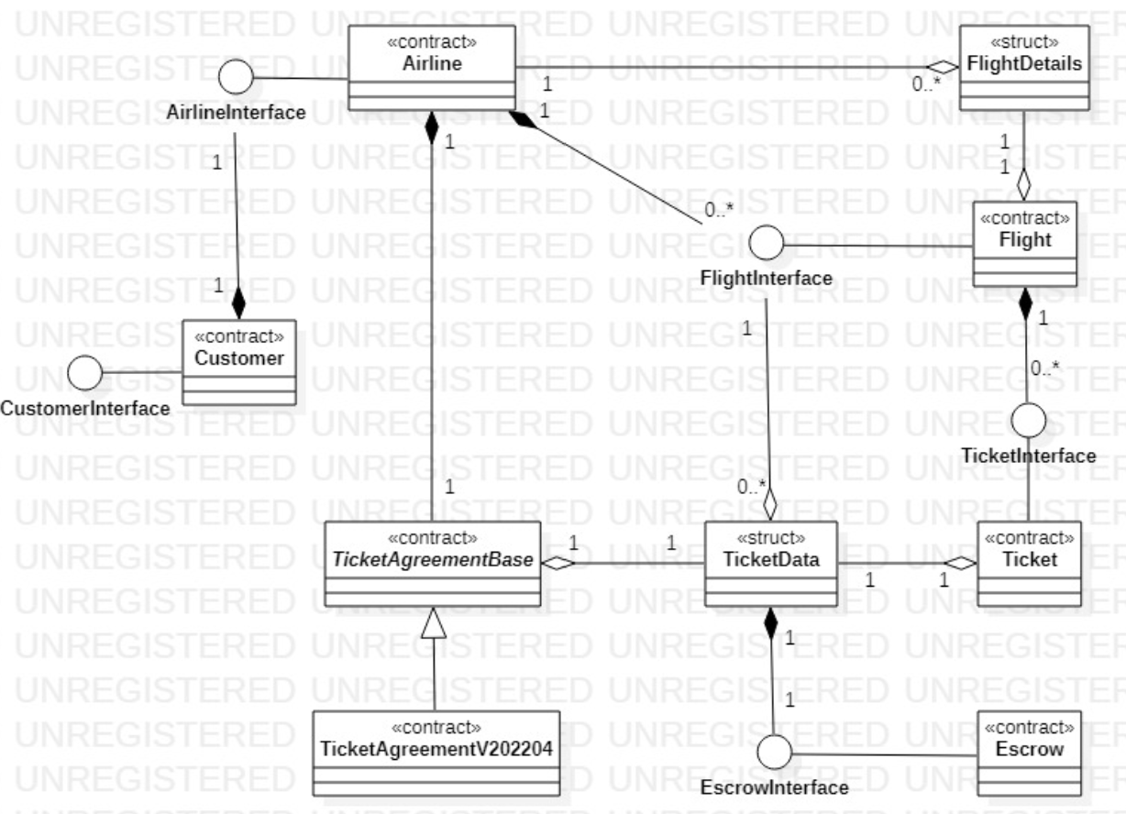
SMART Contracts

Slide 3
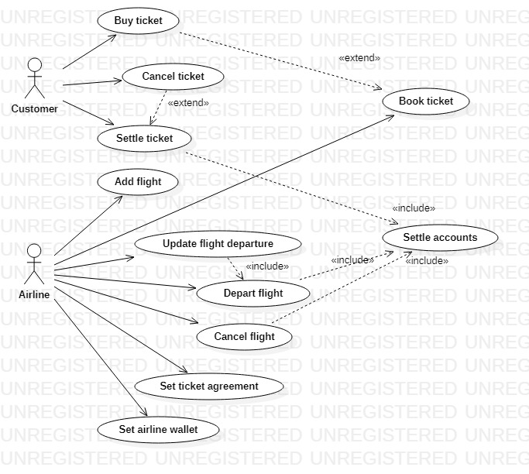
Actors & use cases

Slide 4
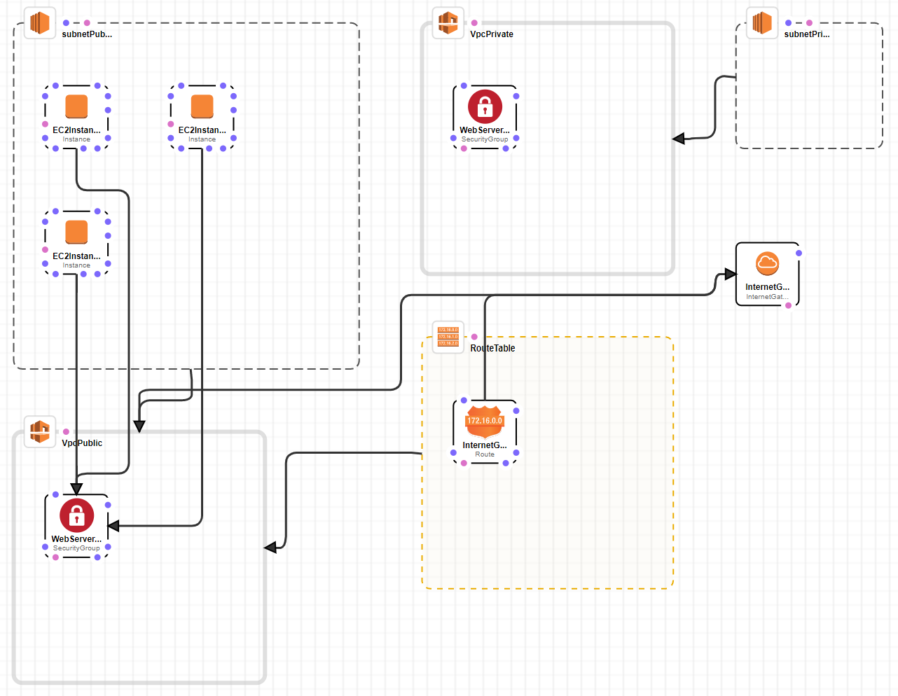
Blockchain Infra - cloud

Slide 5

Blockchain Infra - GETH
(Boot Node)
EC2 Machine 1
EC2 Machine 2
EC2 Machine 3
Vishal - Customer Account
Swami - Customer Account
Pinakin - Customer Account
Madhavi - Customer Account
EagleAccount1- Sealer Account
EagleAccount2- Sealer Account
Escrow Account
(Smart Contract)

Slide 6
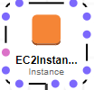
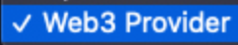

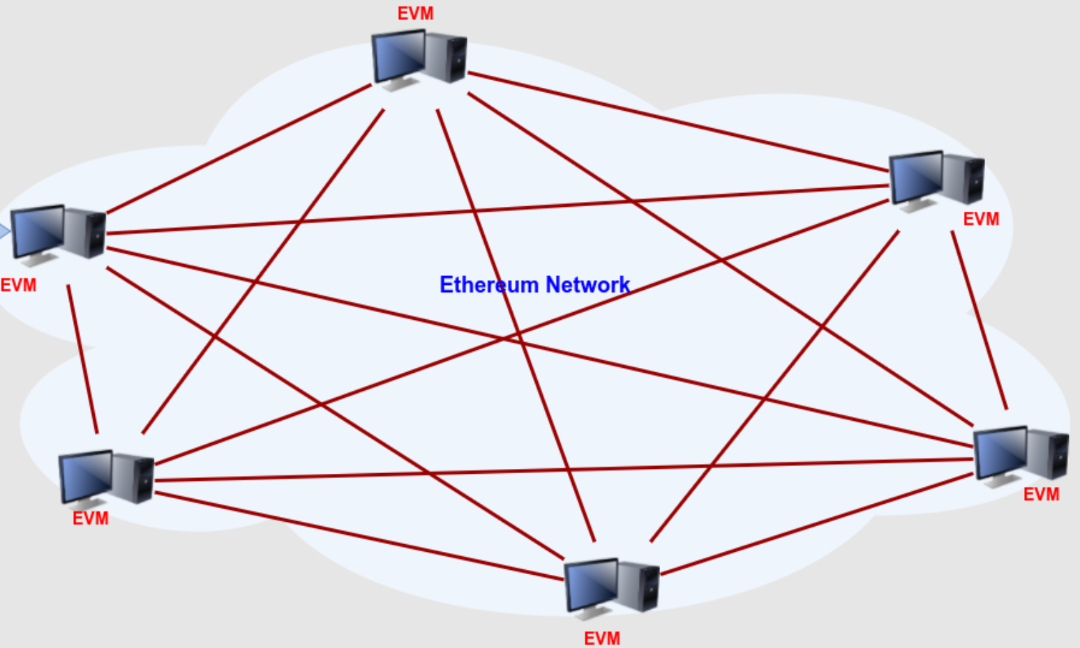
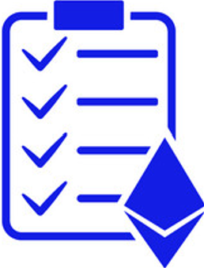


High Level Design
AWS Infra
Remix
Remix
Remix
Web3 Provider
Web3 Provider
Remix
Open Ports- 8545,8546,8547
Ports- 8545,8546,8547
Blockchain Network
Smart Contracts
2 Miners Nodes
4 Customers Nodes
Airline, TicketAgreement,
Customer, Flight, Escrow, Ticket

Slide 7
Sequence Diagram – Buy Ticket
TicketAgreement
Airline(Miner 1)
Customer
Flight
Ticket
Ecrow Account
Airline (Miner 2)
Deploy
Deploy
Deploy
Return Contract Addresses
Set Ticket Agreement
Return Success
Set Wallet (Miner 2 Account)
Return Success
Set Airline
Return Success
Add Flight
Add Flight
Remix
Adding Flight Success
Flight Added
Buy Ticket
Book Ticket
Amount Transferred
Return Ticket Address
Ticket Booked
Update Flight Depart
Update Depart
Updated Depart Time
Updated Depart
Flight Depart
Depart Flight
Settle Accounts
Withdraw Amount
Wei Transferred
Flight Departed
Flight Departed

Slide 8
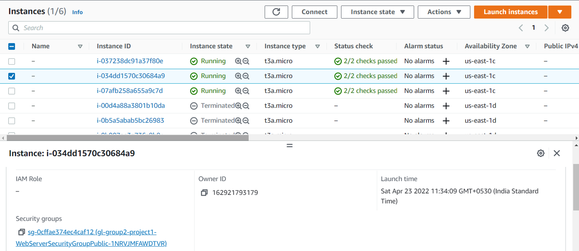
EC2 Instances – Boot and Geth Nodes

Slide 9
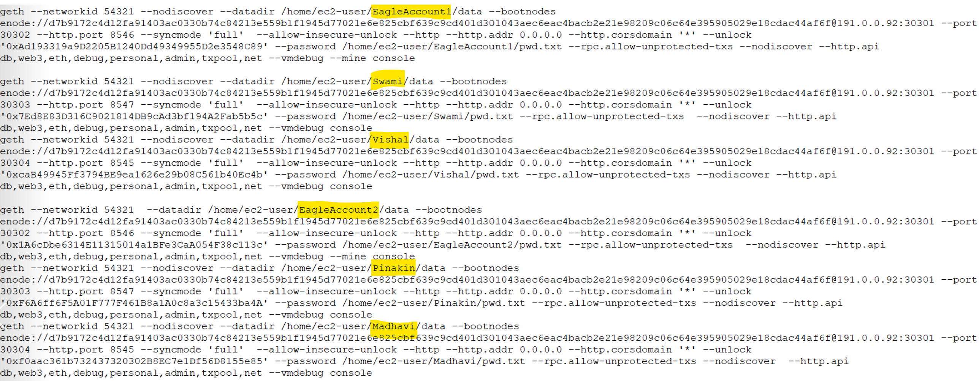
Geth Accounts start Commands

Slide 10
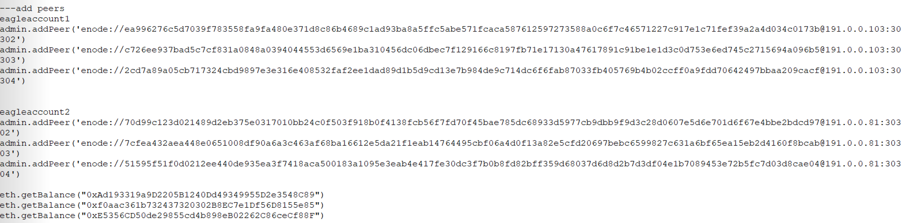
Add peers, checking balance and send txn

Slide 11
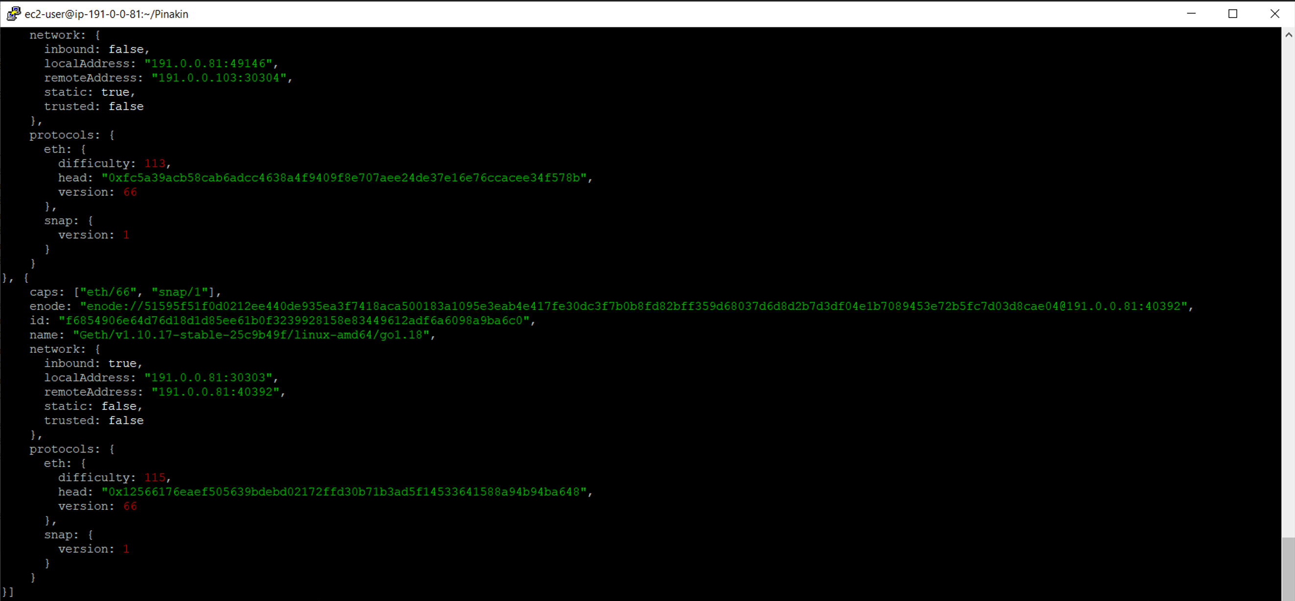
verify peers

Slide 12
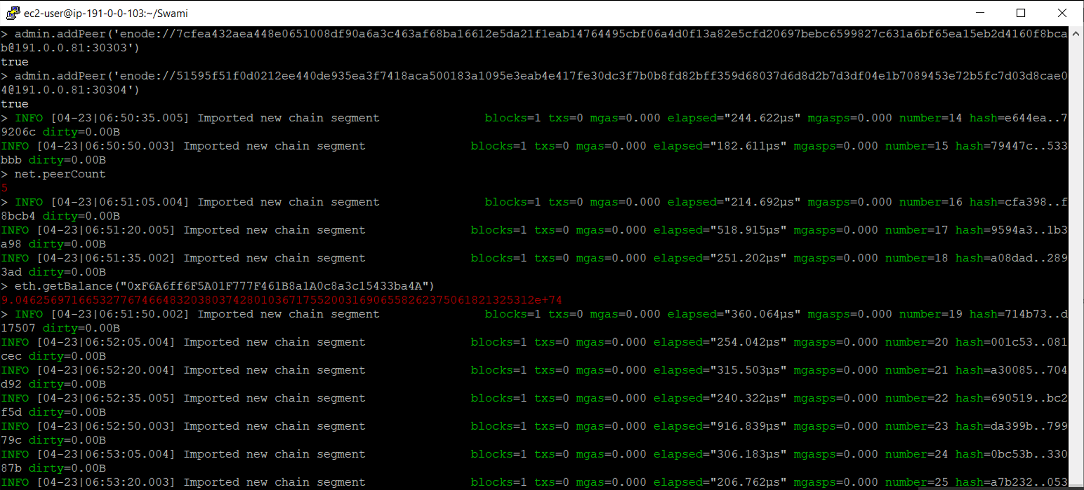
GET balance – Same Ec2 Machine

Slide 13
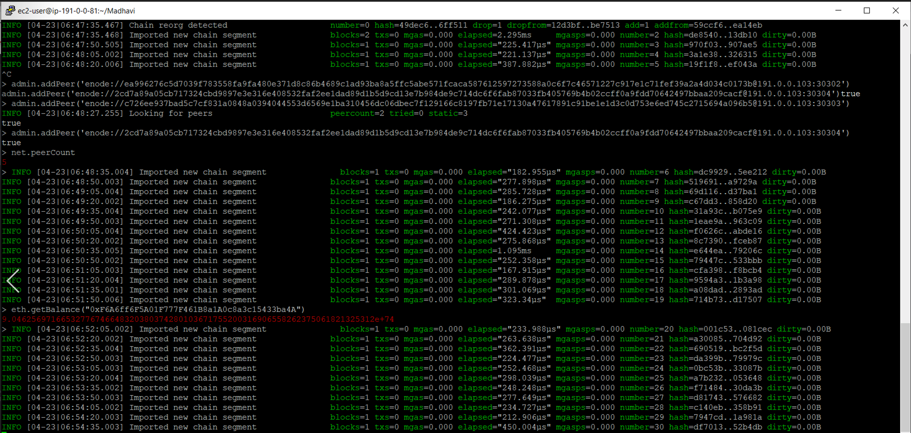
GET balance – Different Ec2 Machine

Slide 14
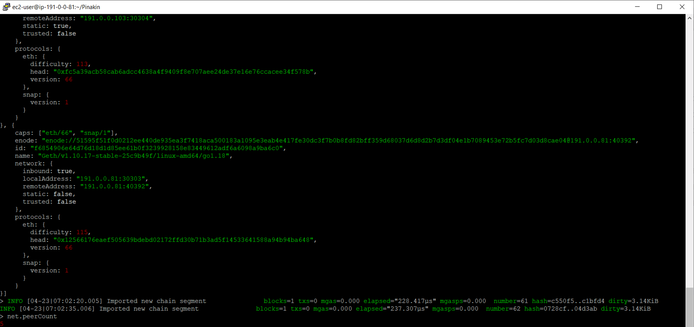
Checking Peer Count

Slide 15
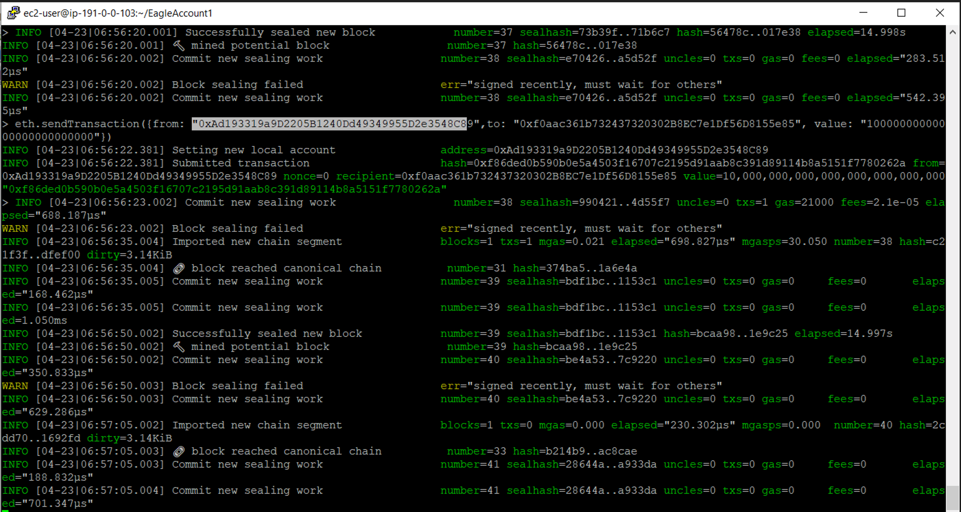
Send TxN with Different ec2 geth account
GET balance

Slide 16
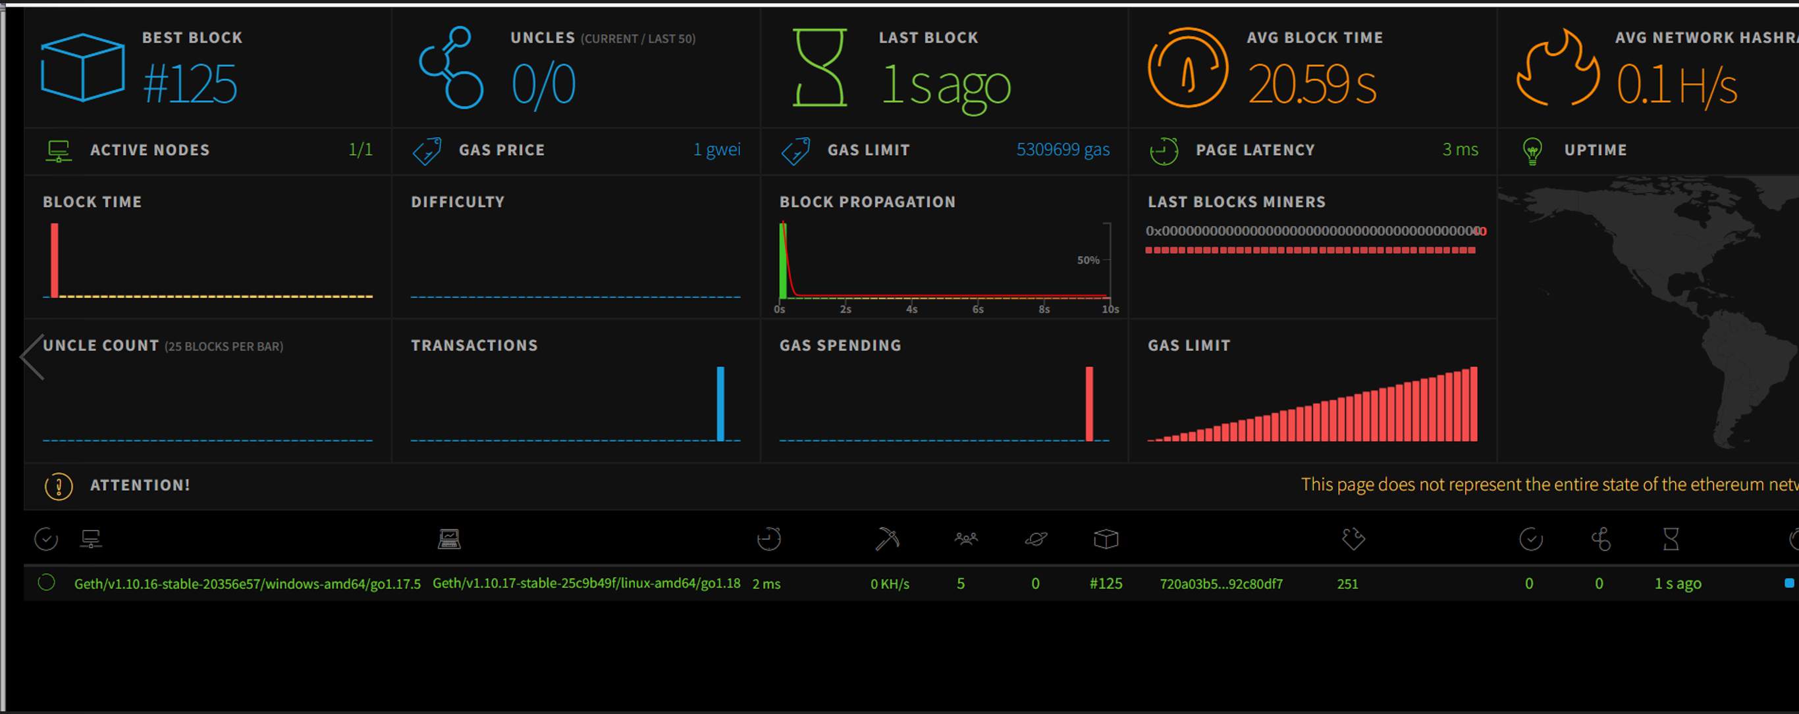
Dashboard – Blockchain Network Monitoring

Slide 17
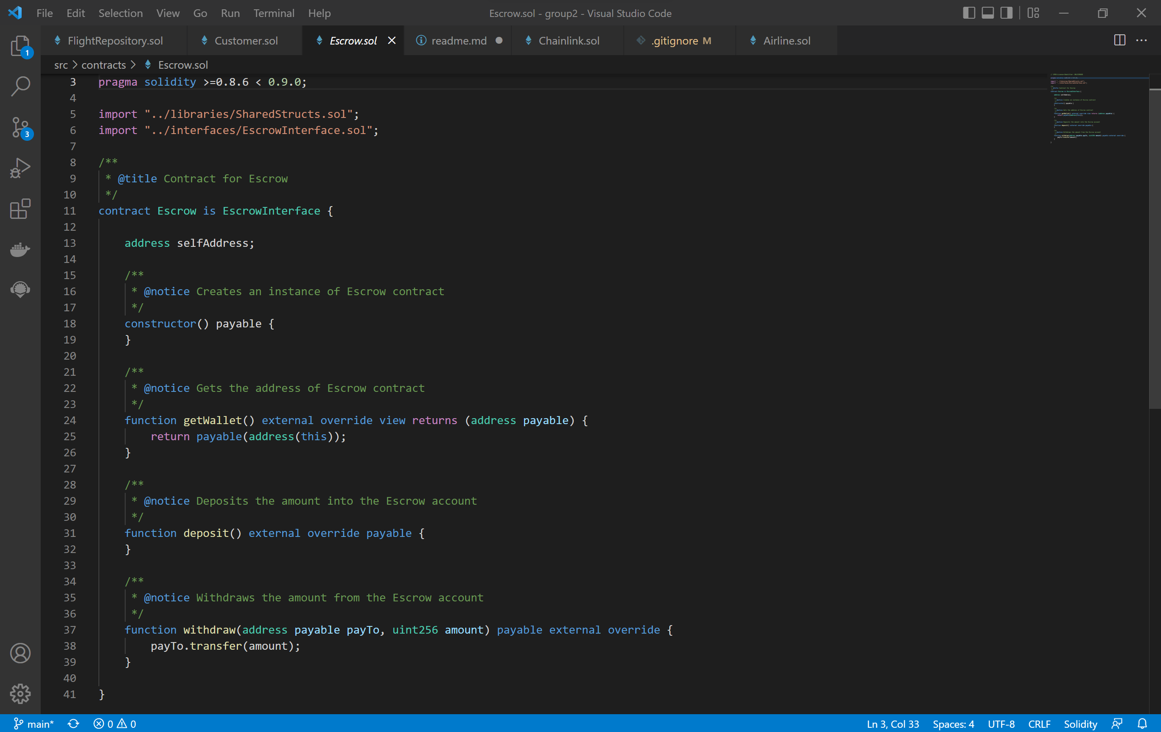
ESCROW SMART CONTRACT CODE

Slide 18
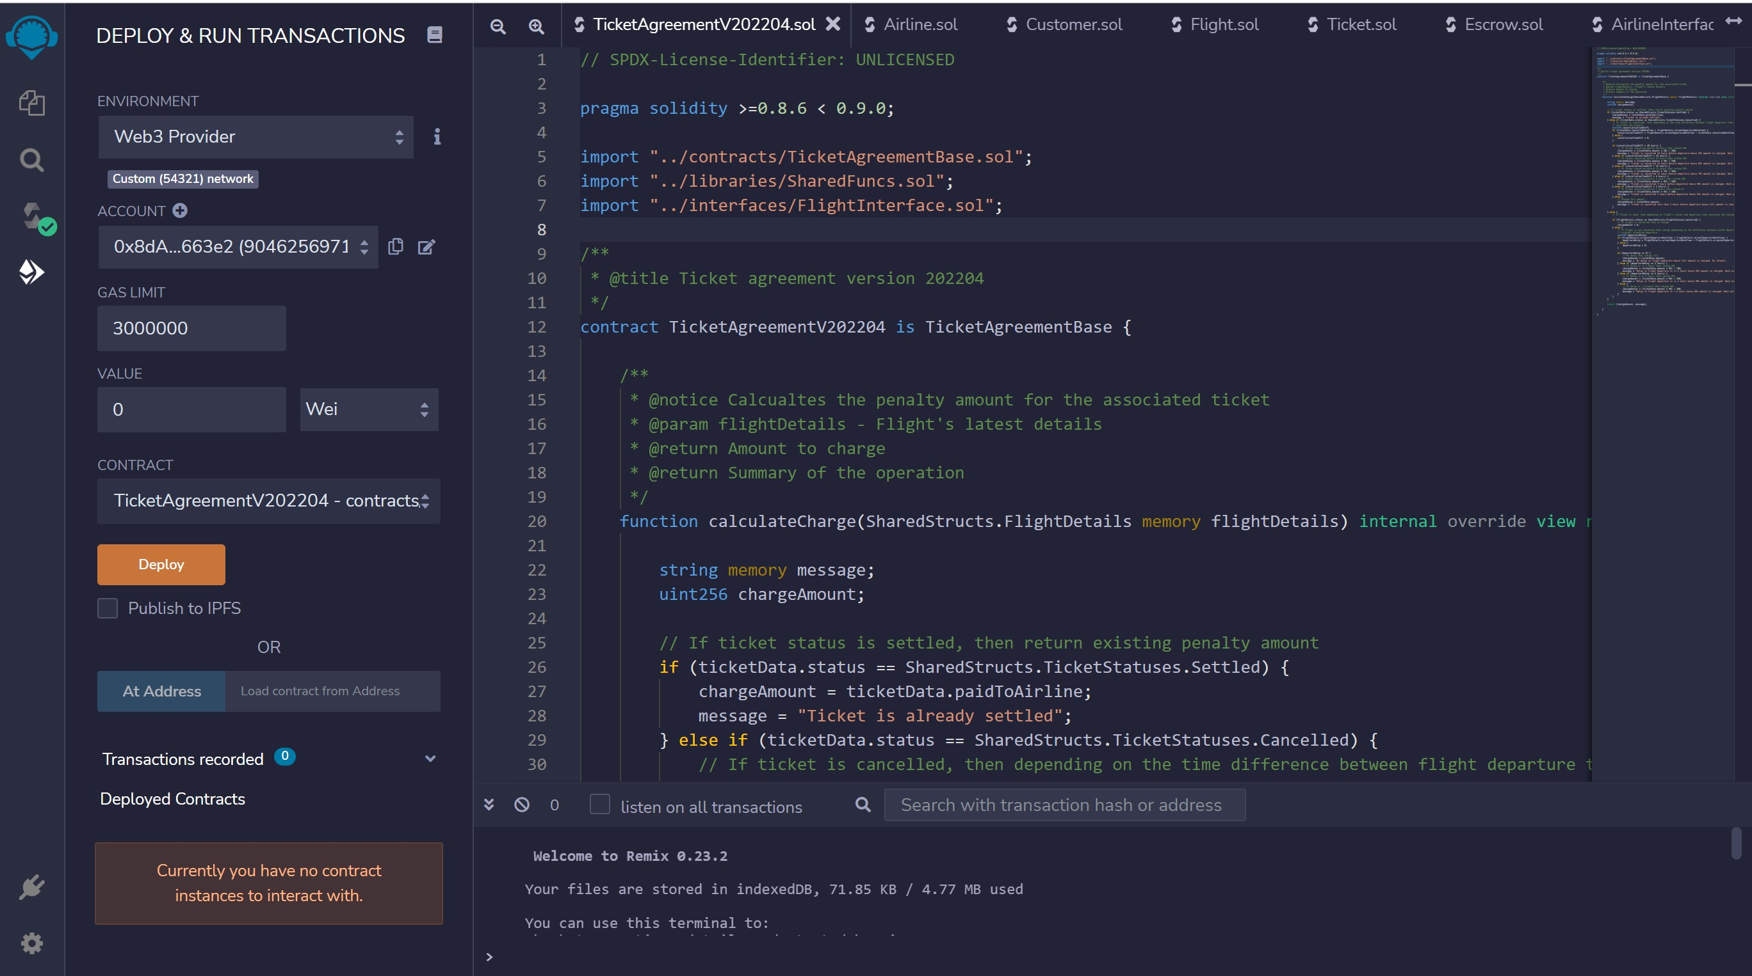
CONNECT TO NETWORK WITH AIRLINE A/C MINER 1

Slide 19
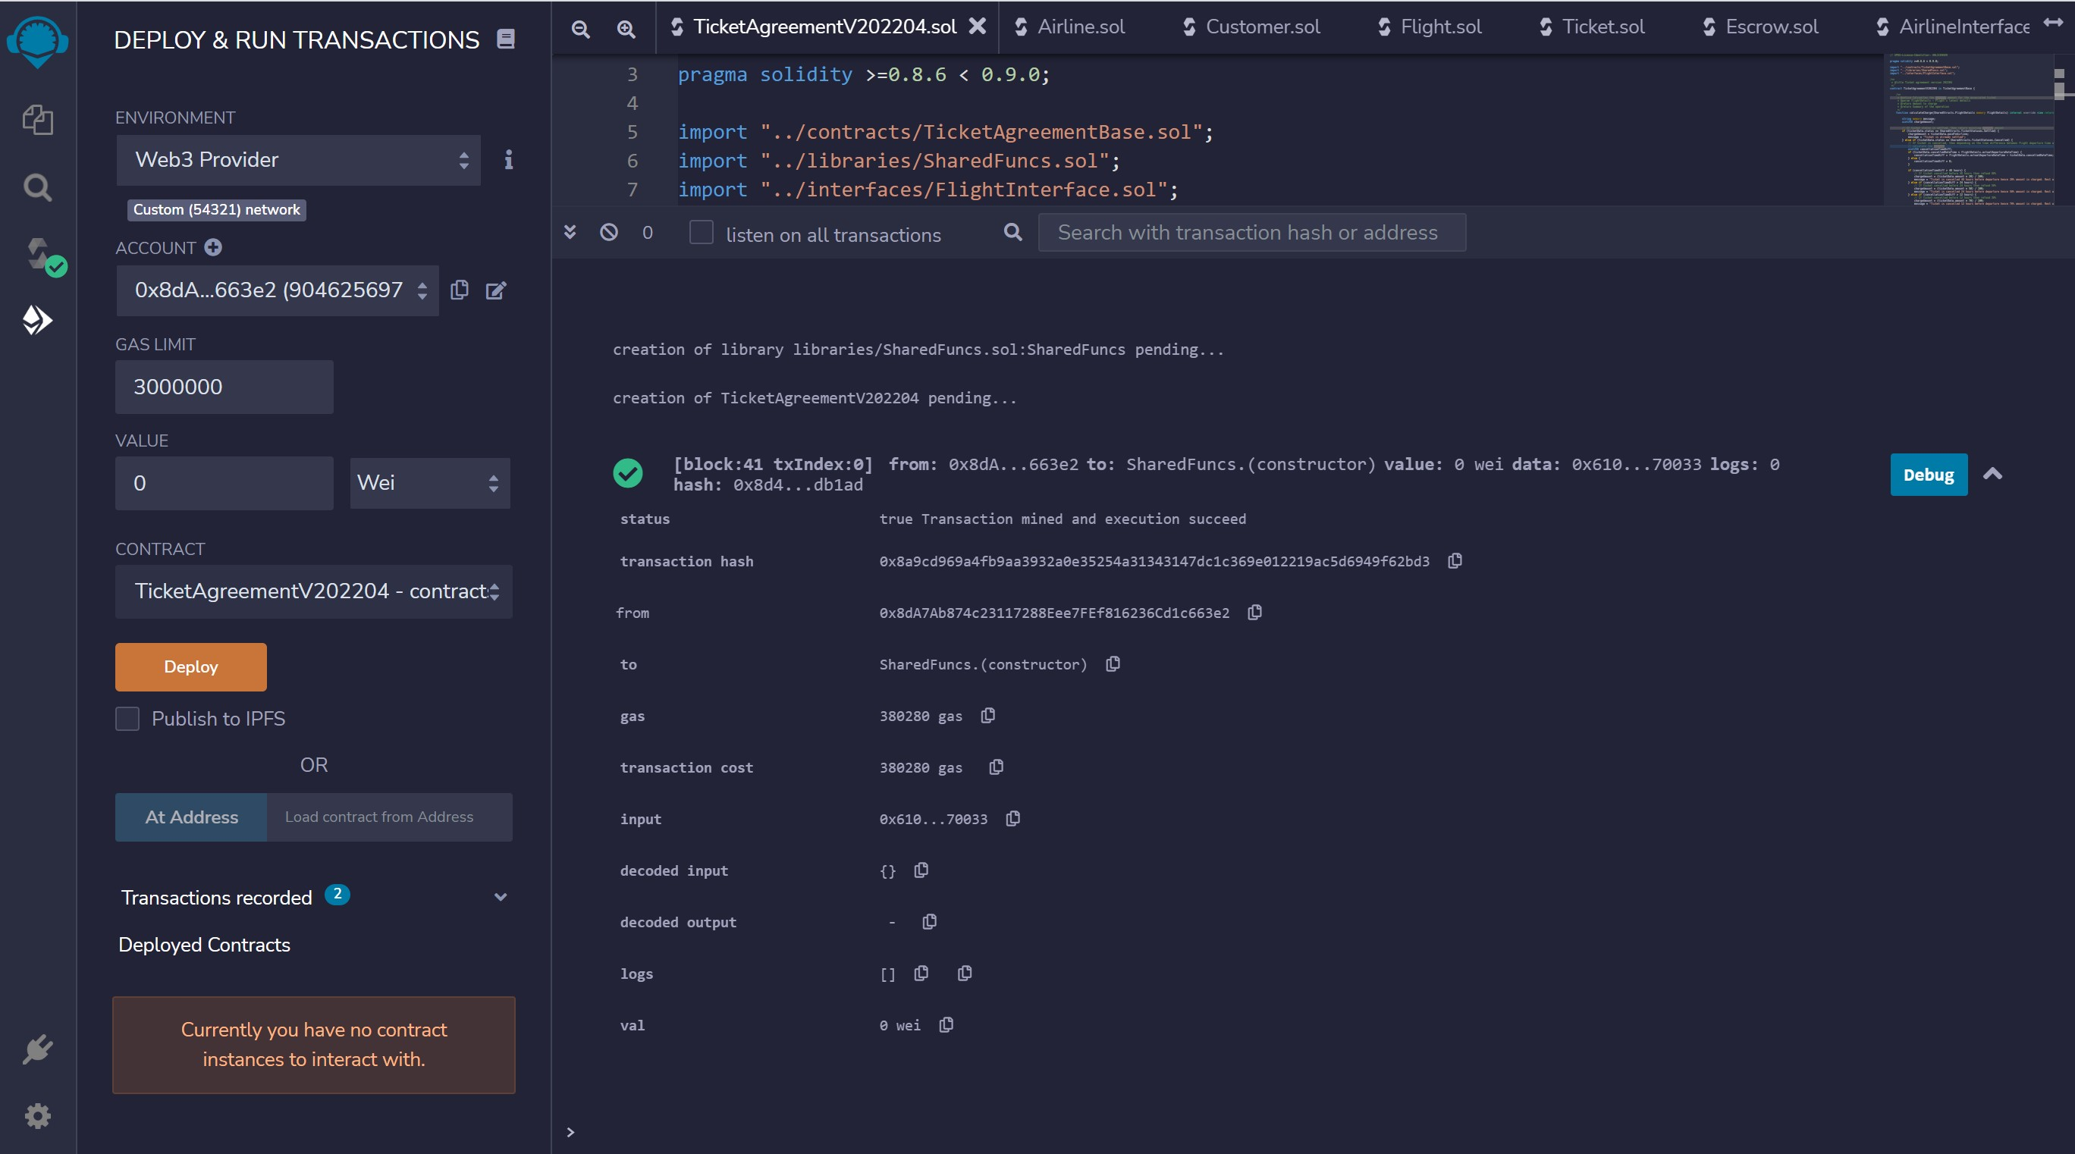
DEPLOY TICKET AGREEMENT CONTRACT

Slide 20
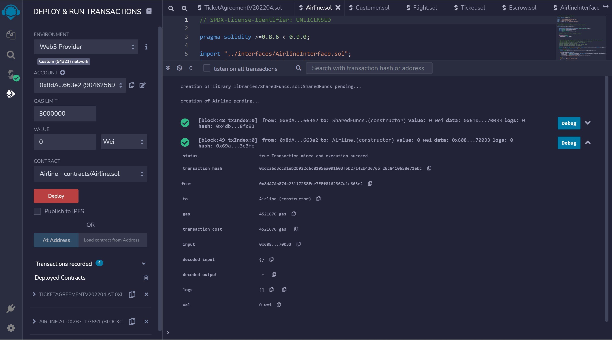
DEPLOY AIRLINE CONTRACT

Slide 21
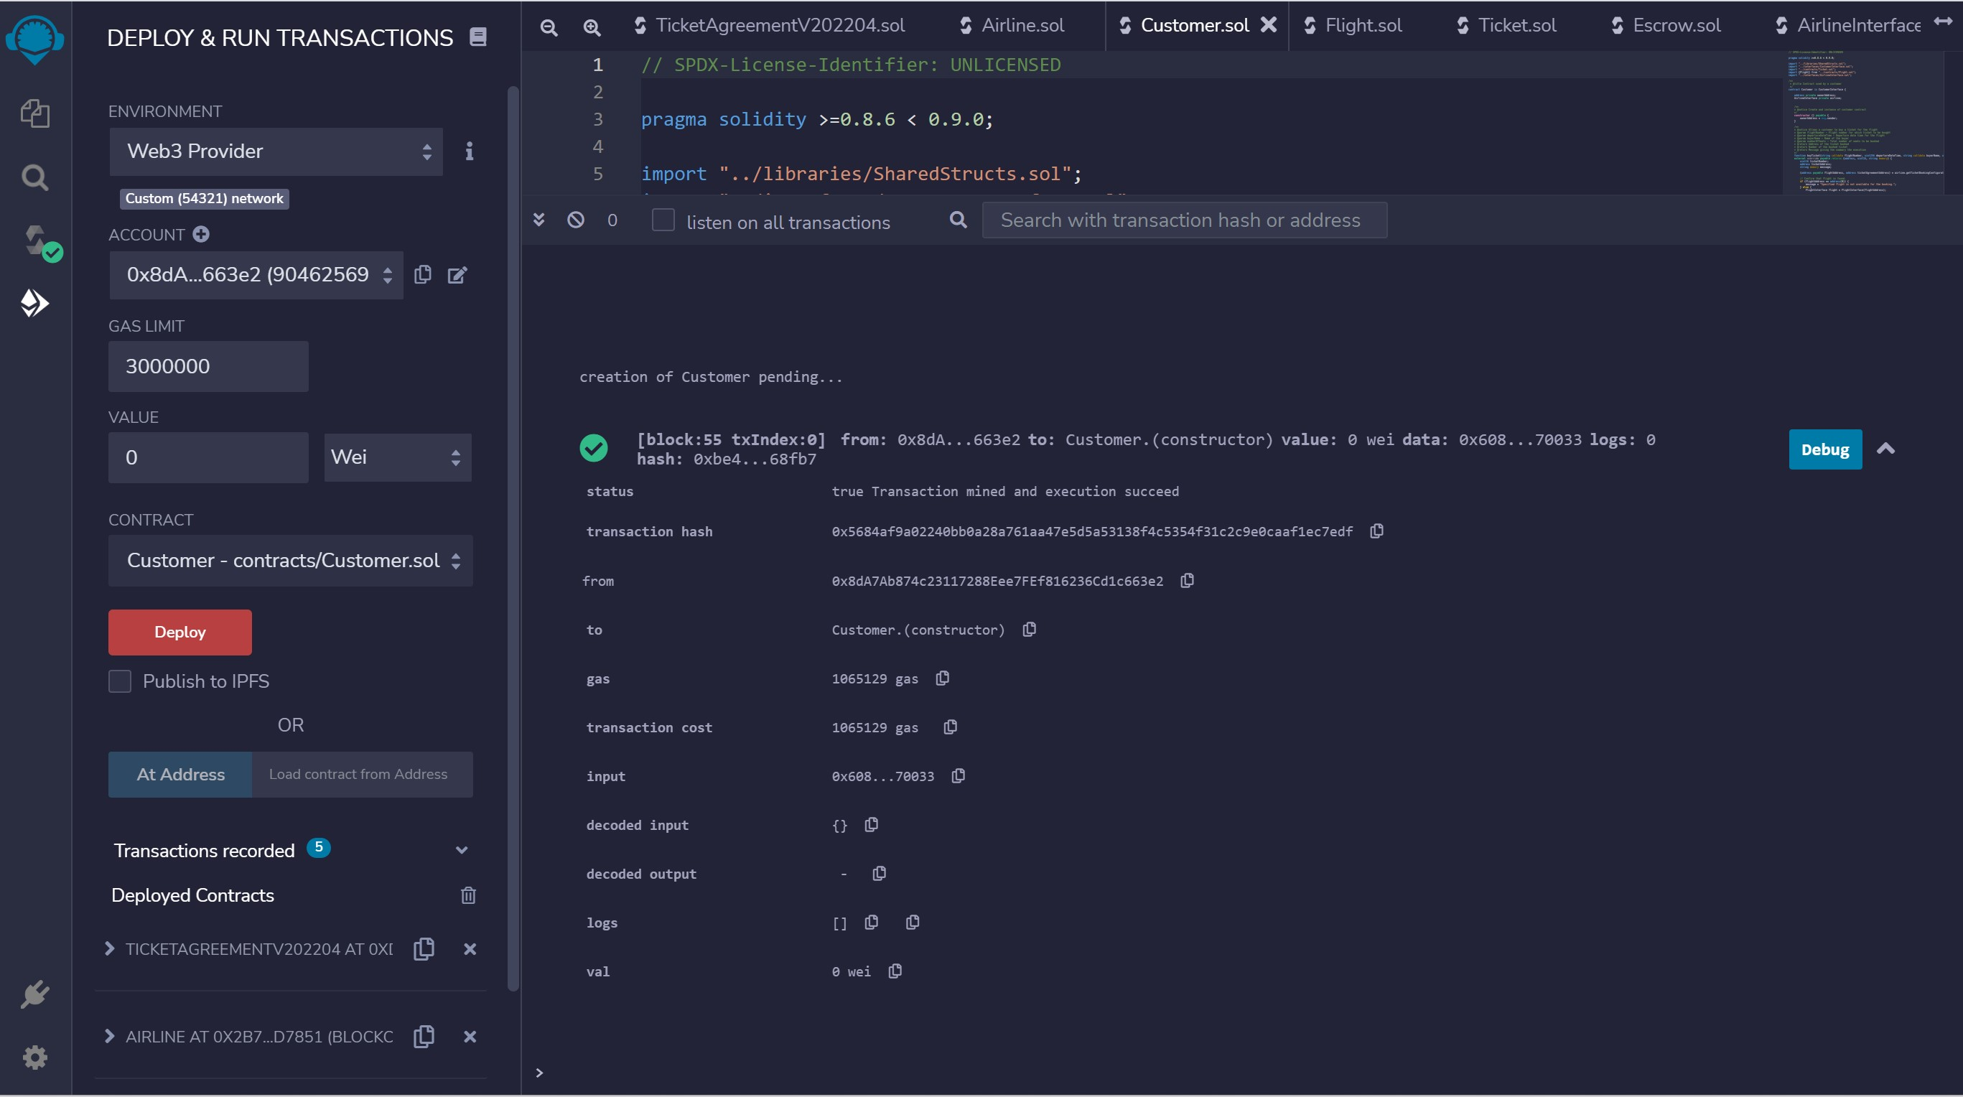
DEPLOY CUSTOMER CONTRACT

Slide 22
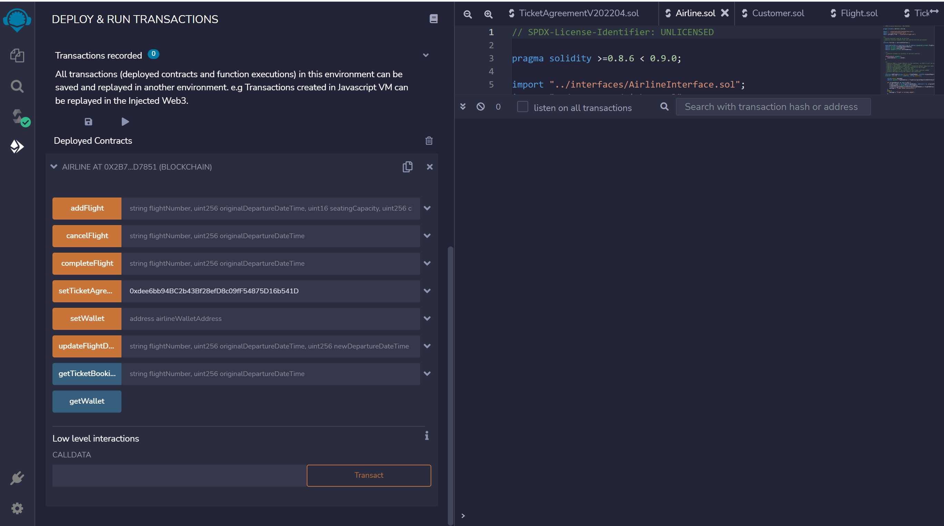
SET TICKET AGREEMENT

Slide 23
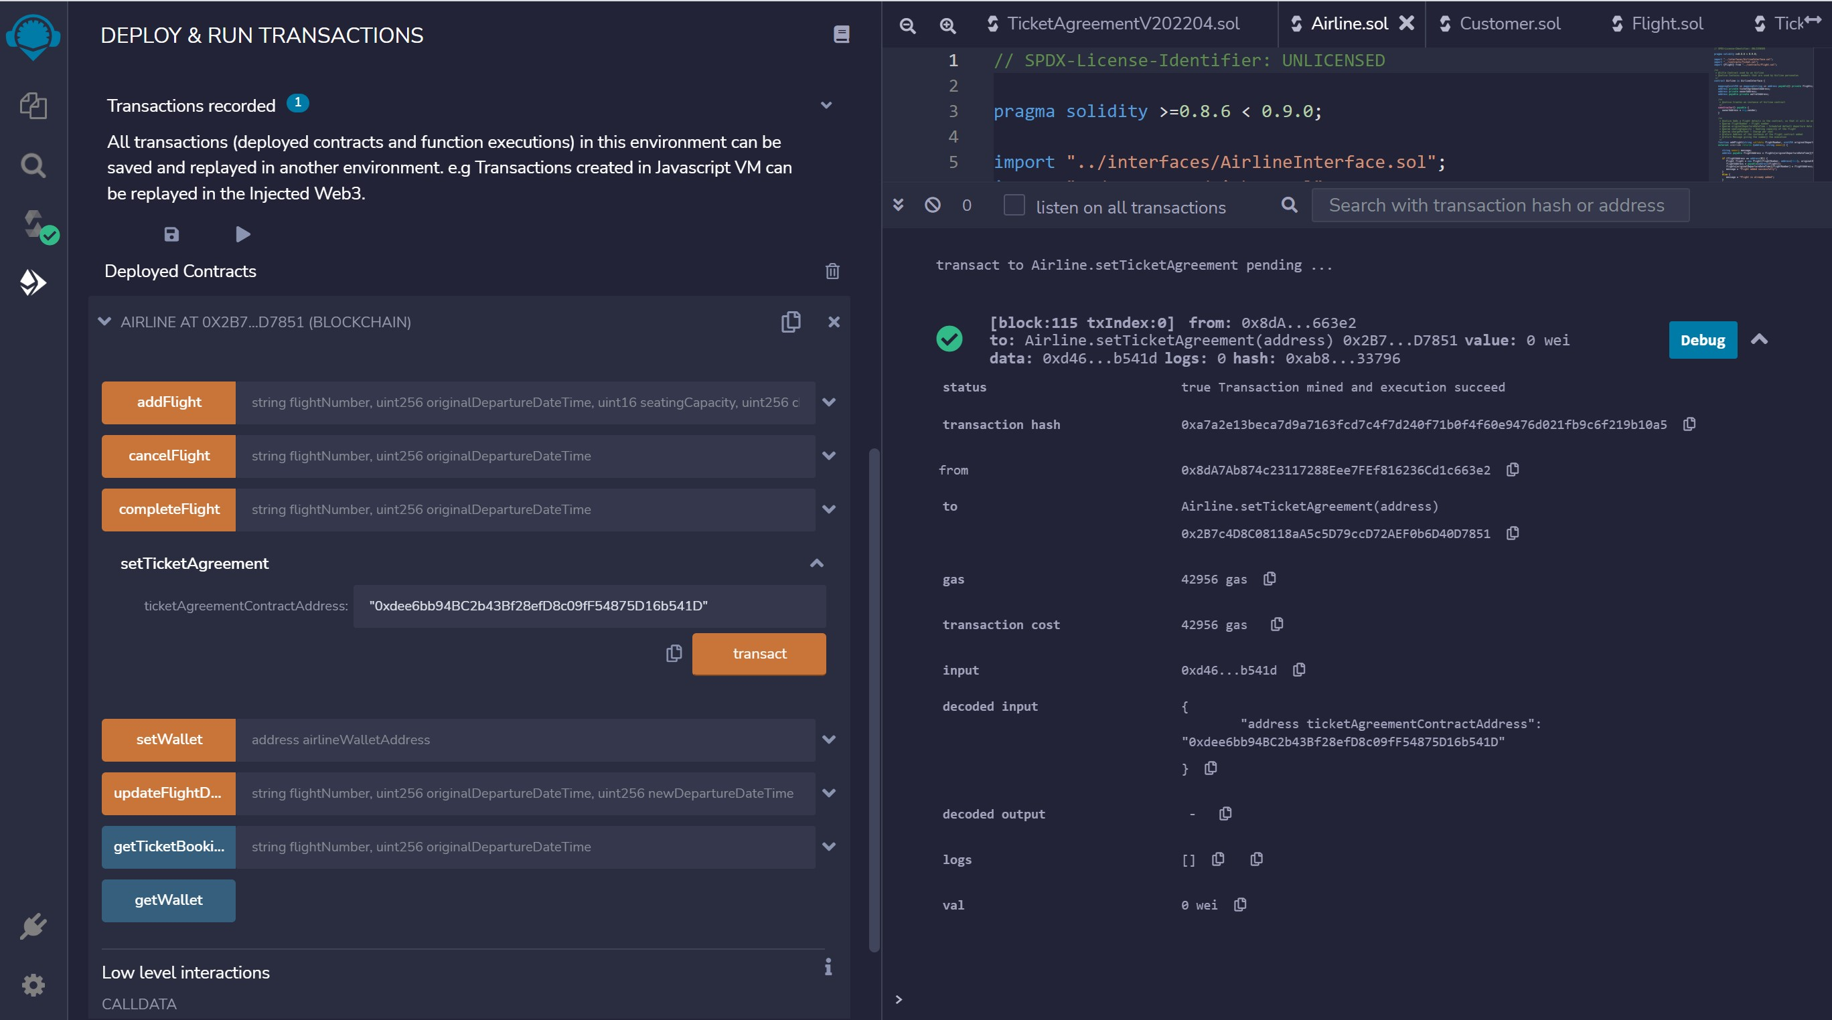
SET TICKET AGREEMENT - TXN

Slide 24
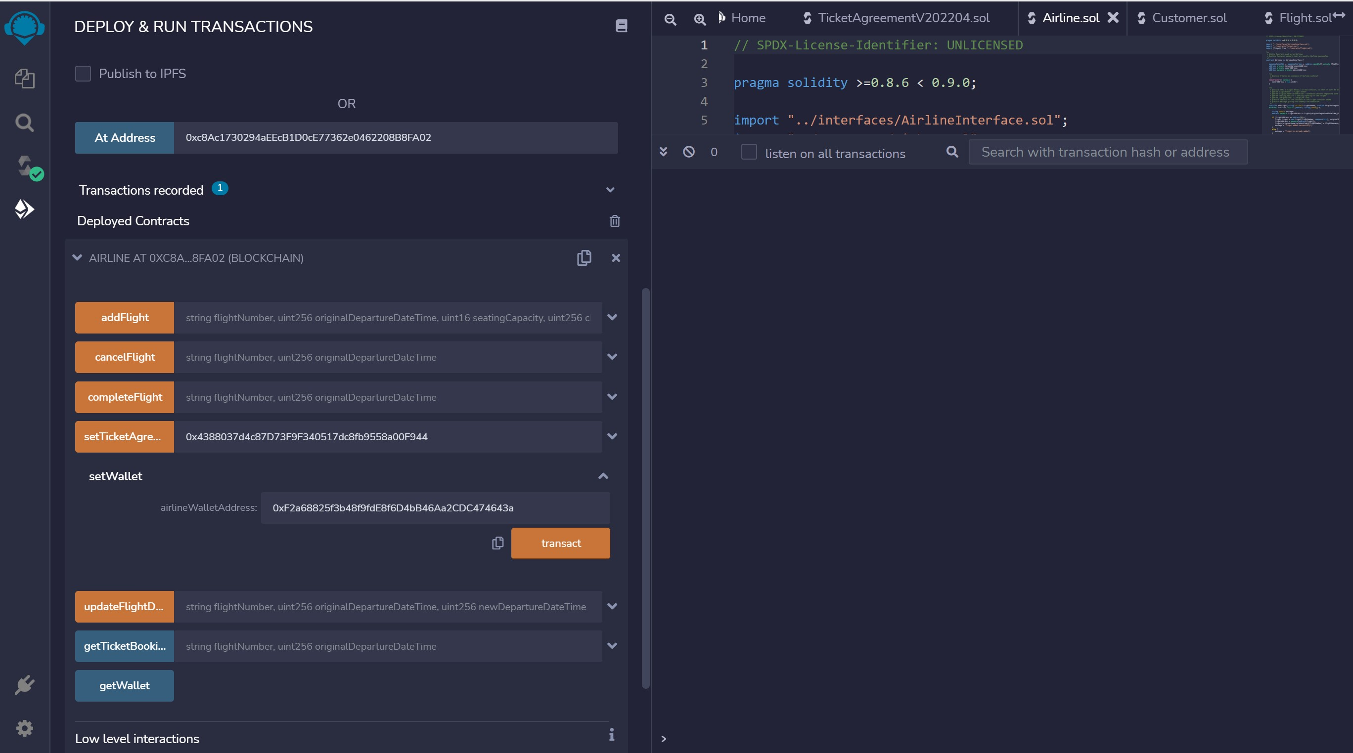
SET WALLET – AIRLINE ACCOUNT MINER 2

Slide 25
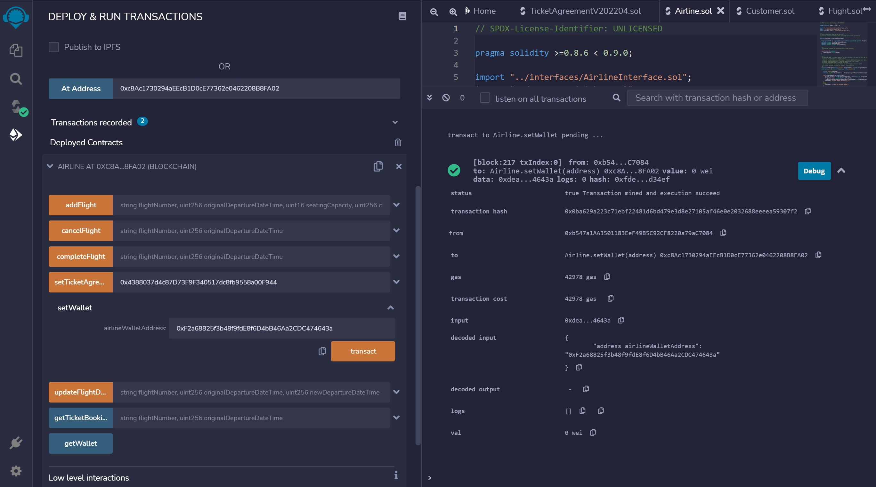
SET WALLET – AIRLINE ACCOUNT MINER 2 - TXN

Slide 26
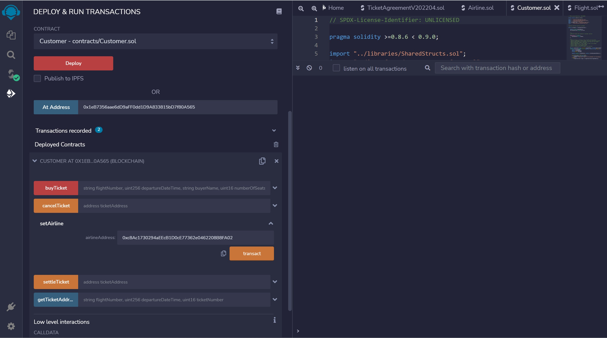
CUSTOMER – SET AIRLINE

Slide 27
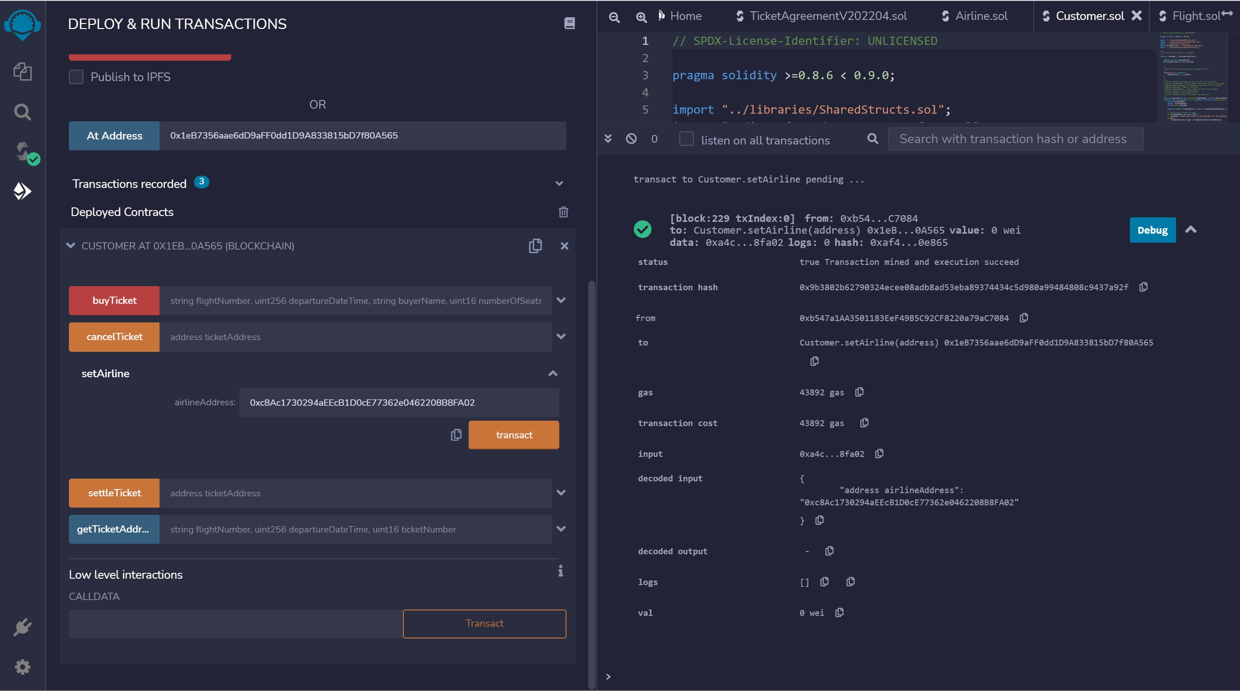
CUSTOMER – SET AIRLINE - TXN

Slide 28
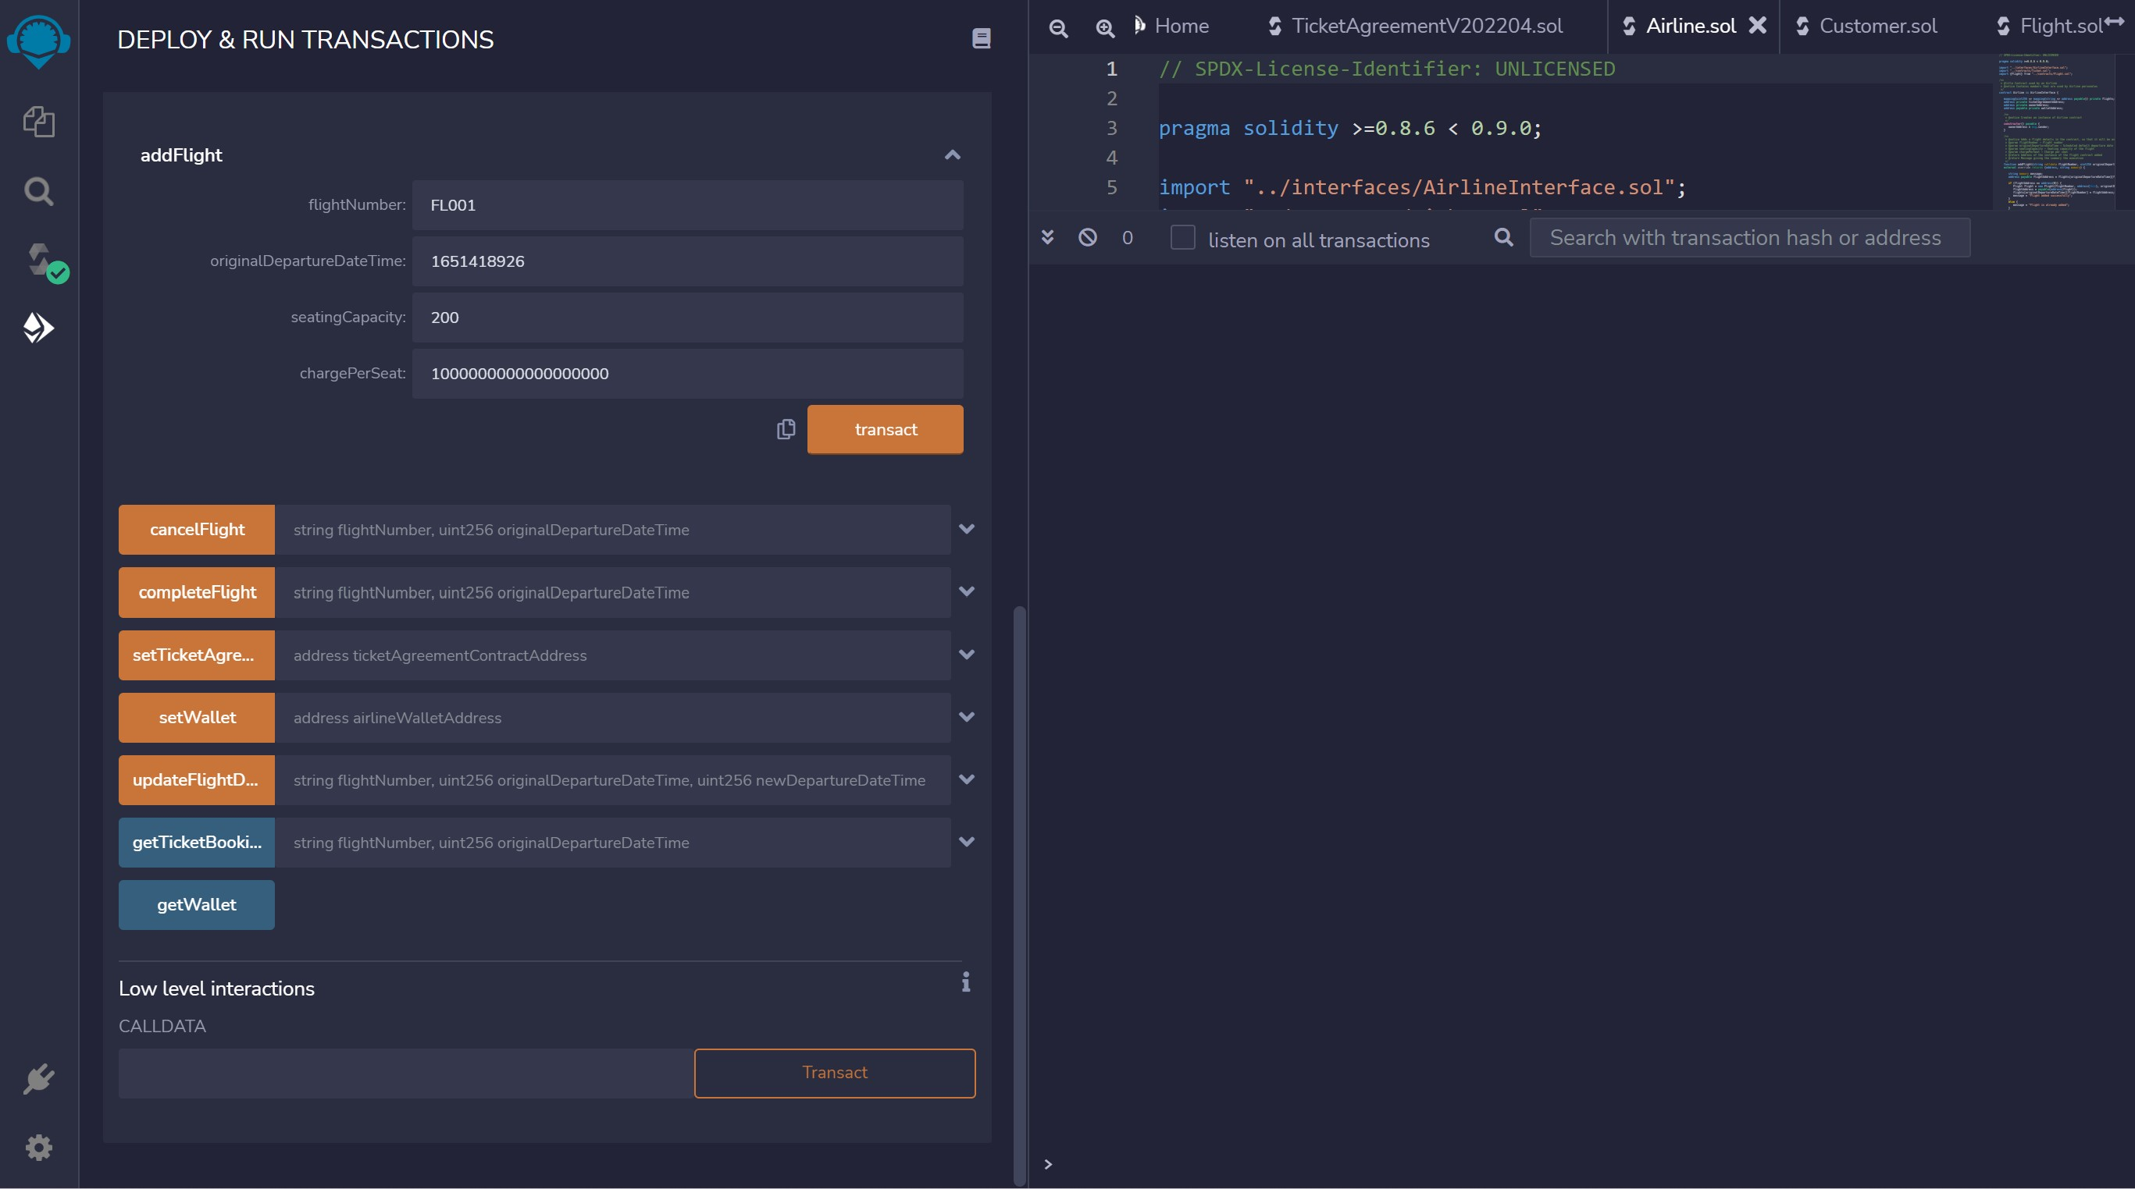
AIRLINE – ADD FLIGHT

Slide 29
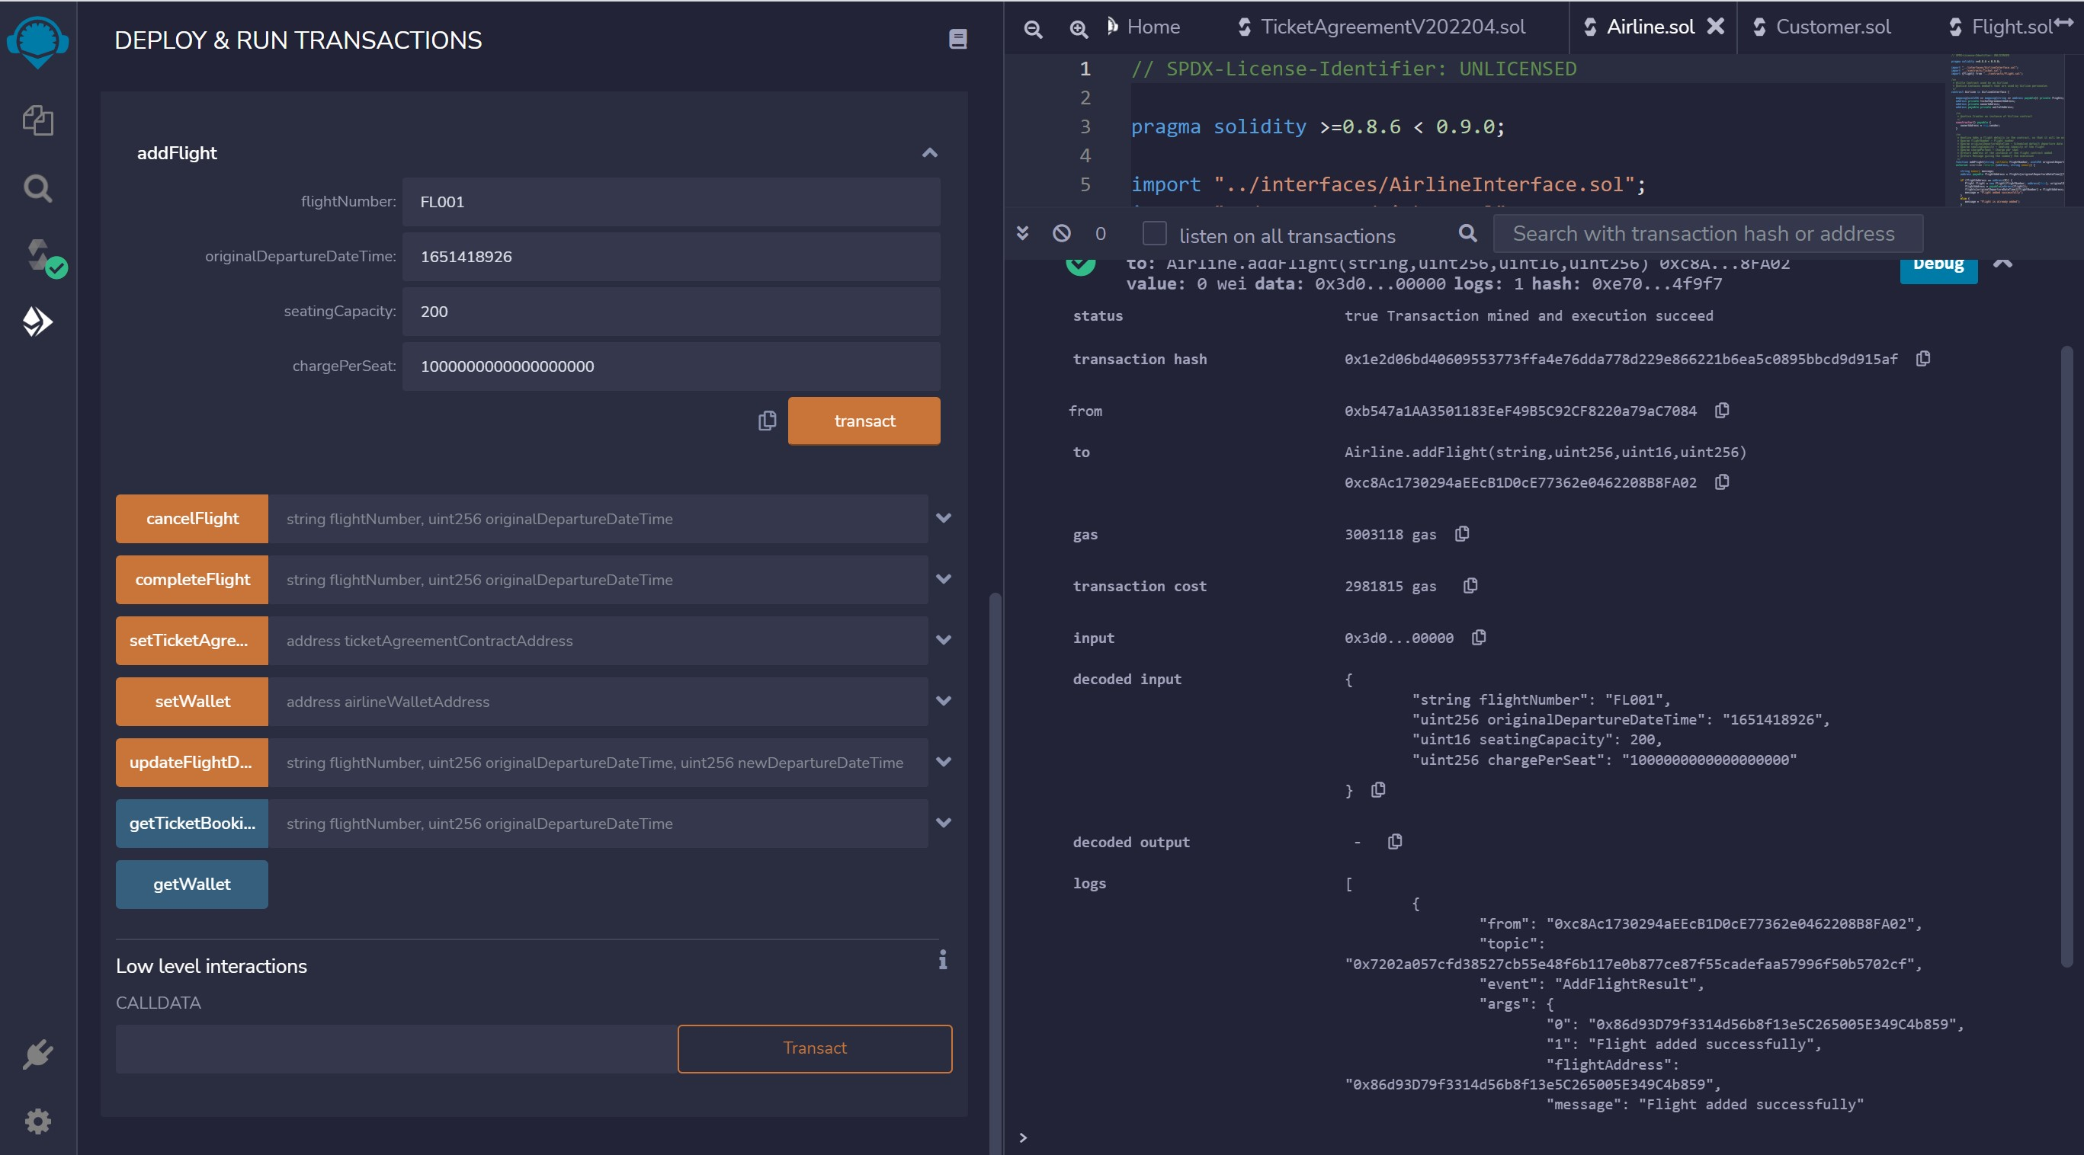
AIRLINE – ADD FLIGHT - TXN

Slide 30
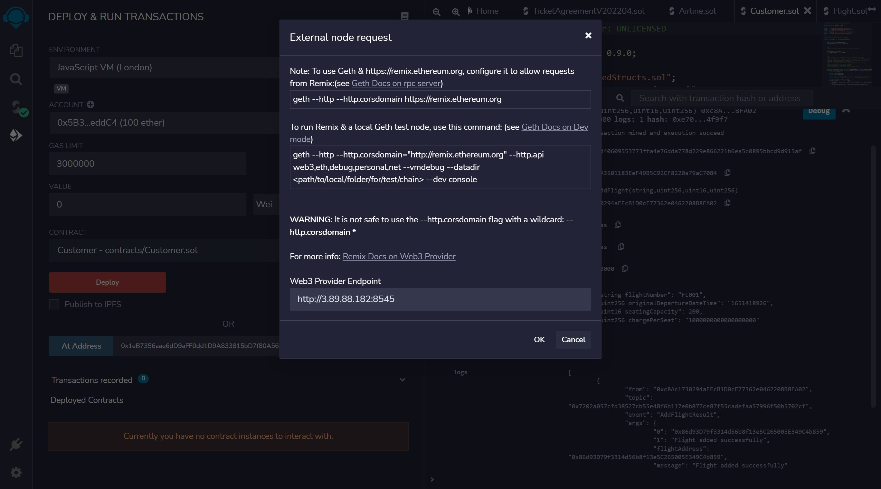
CONNECT TO CUSTOMER ACCOUNT

Slide 31
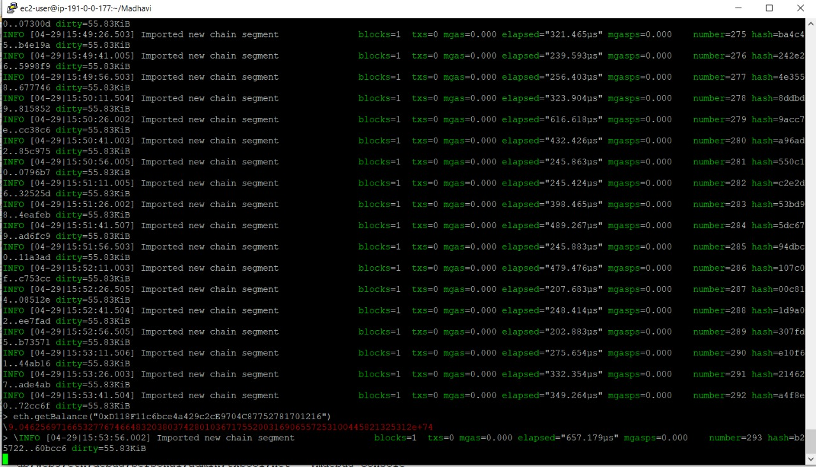
CUSTOMER BALANCE

Slide 32
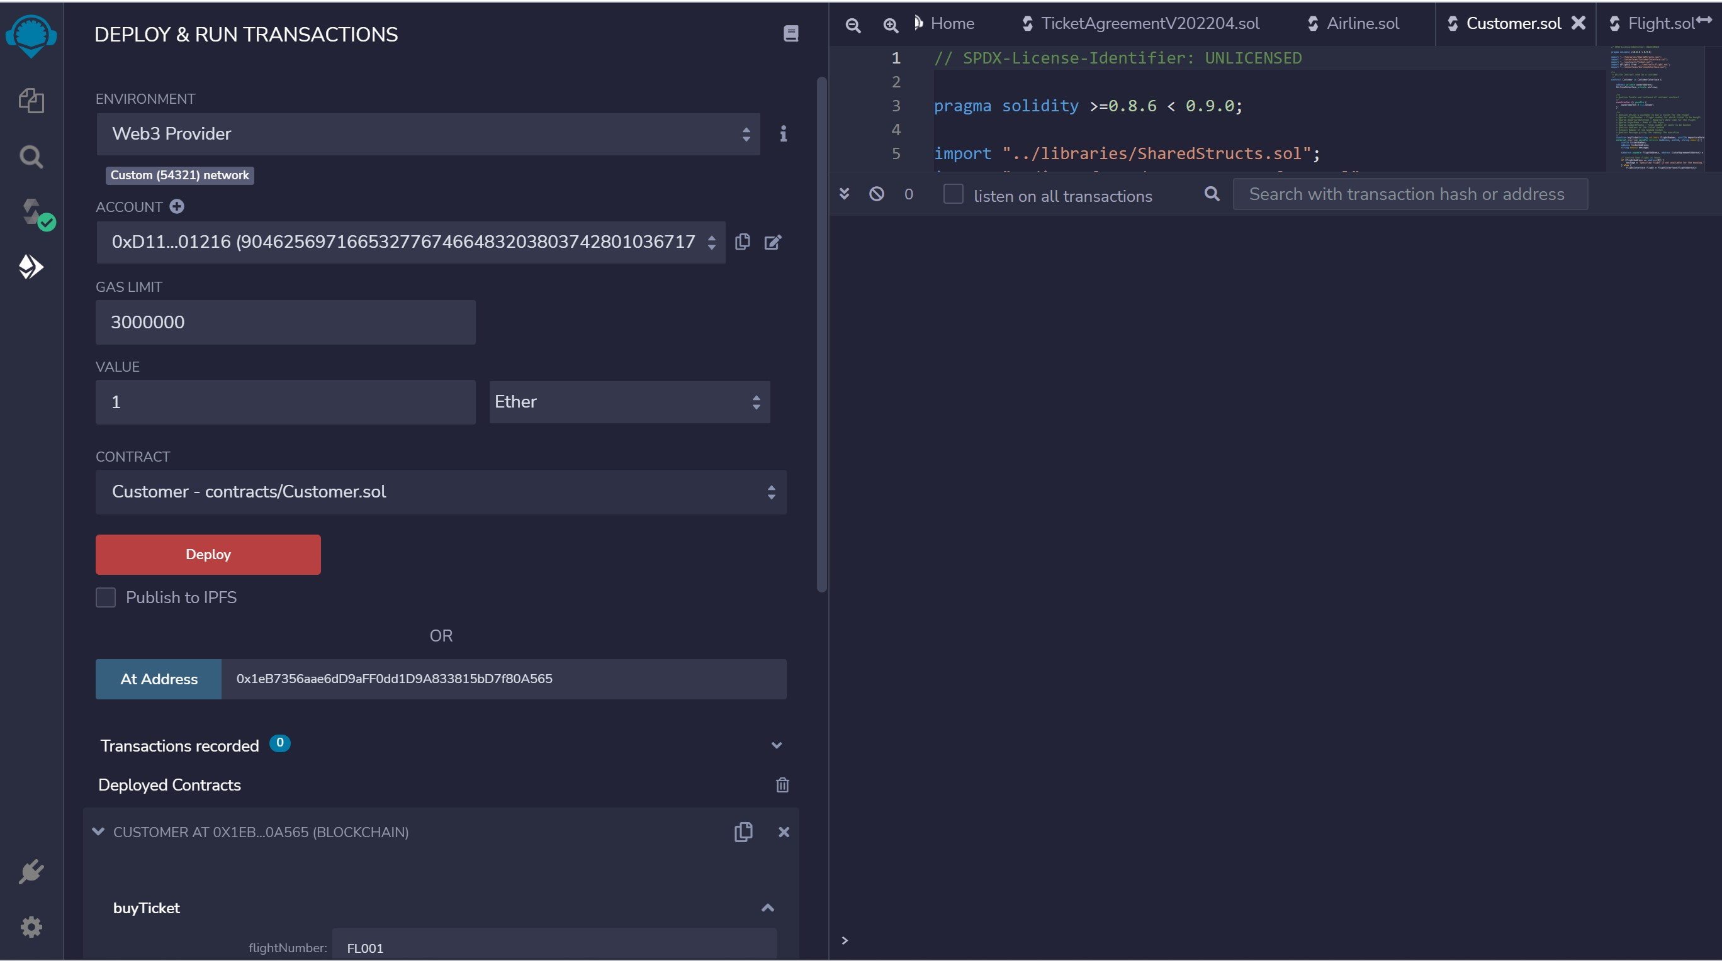
SET TXN AMOUNT TO 1 ETH

Slide 33
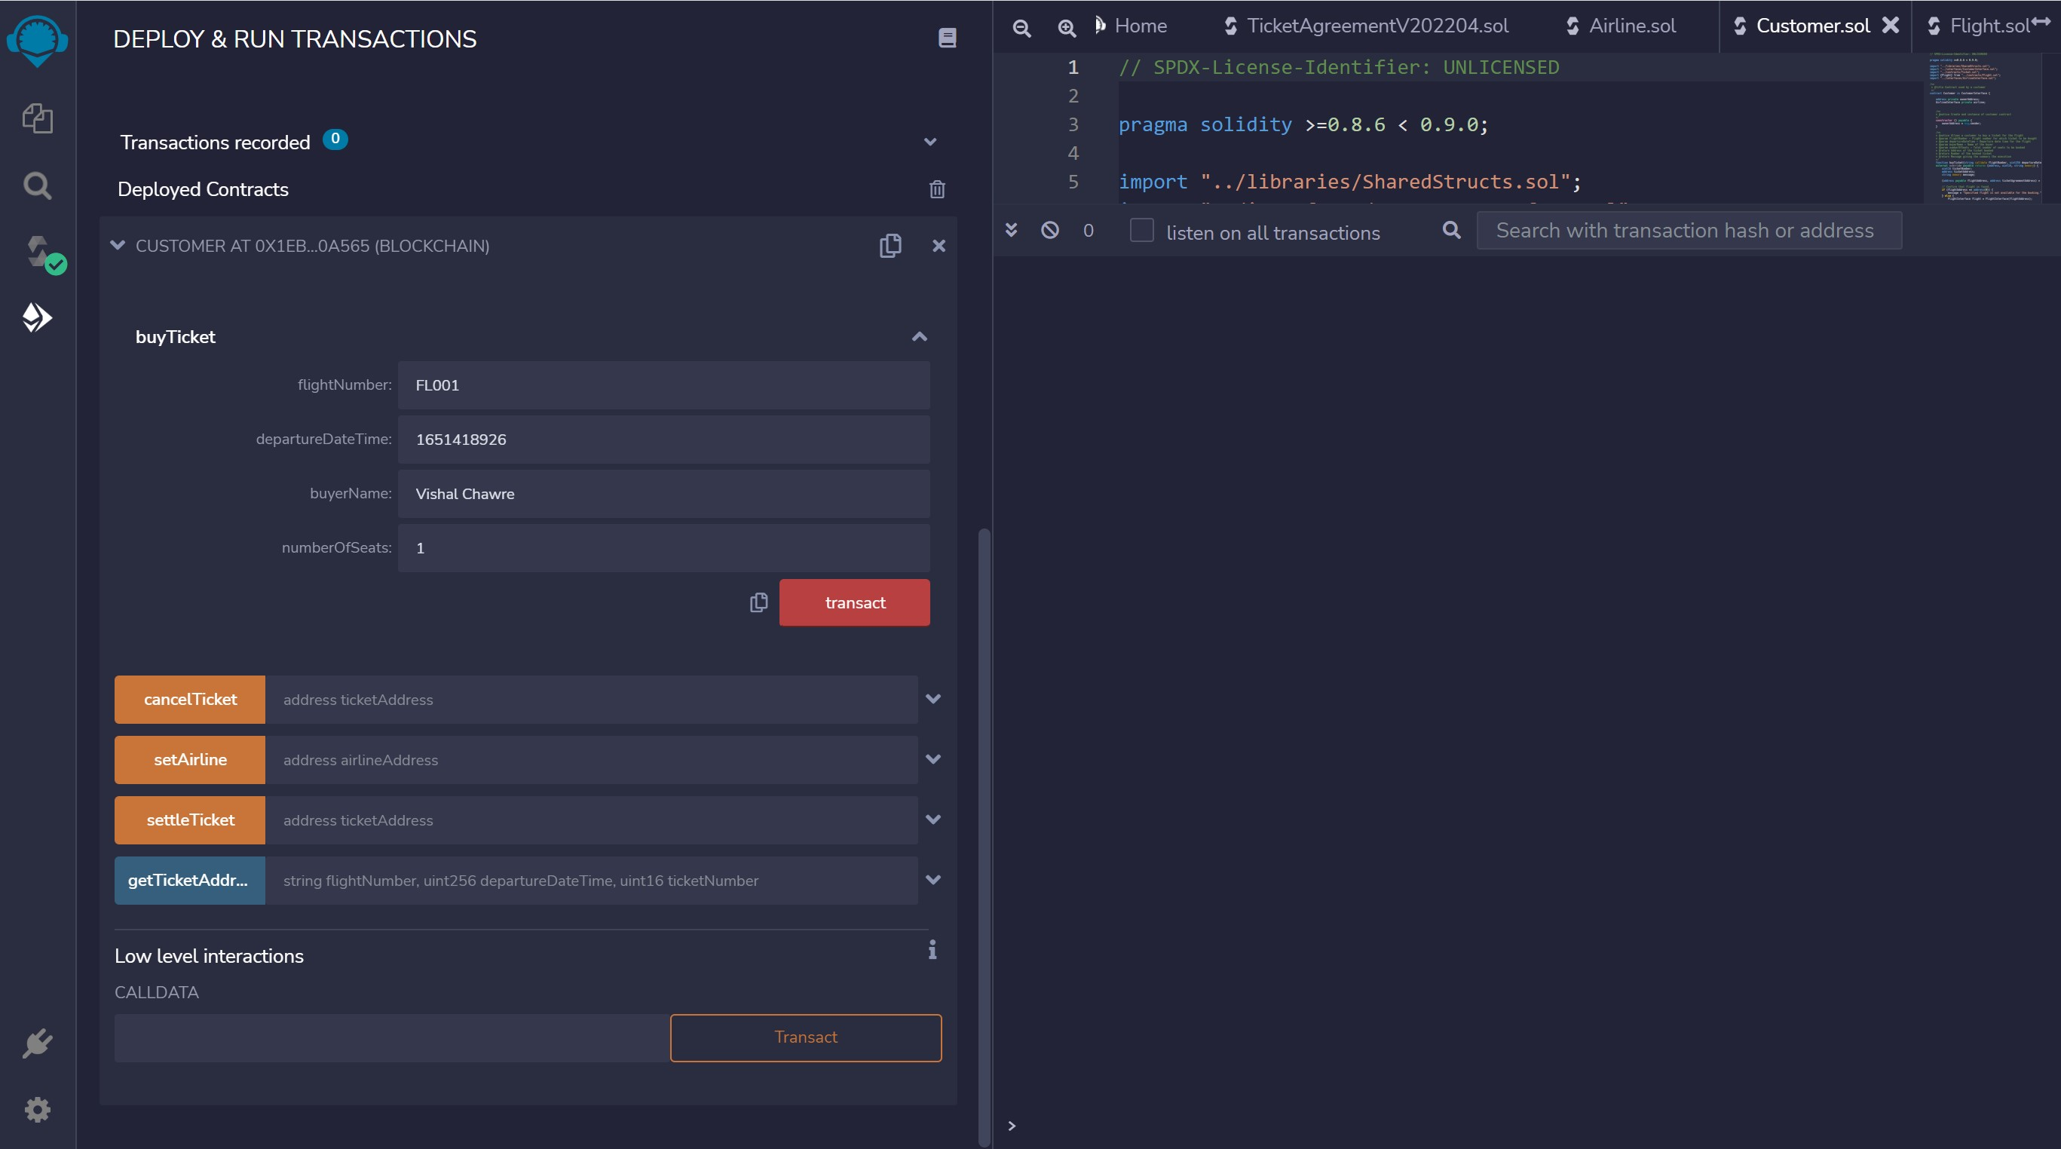
CUSTOMER BUY TICKET

Slide 34
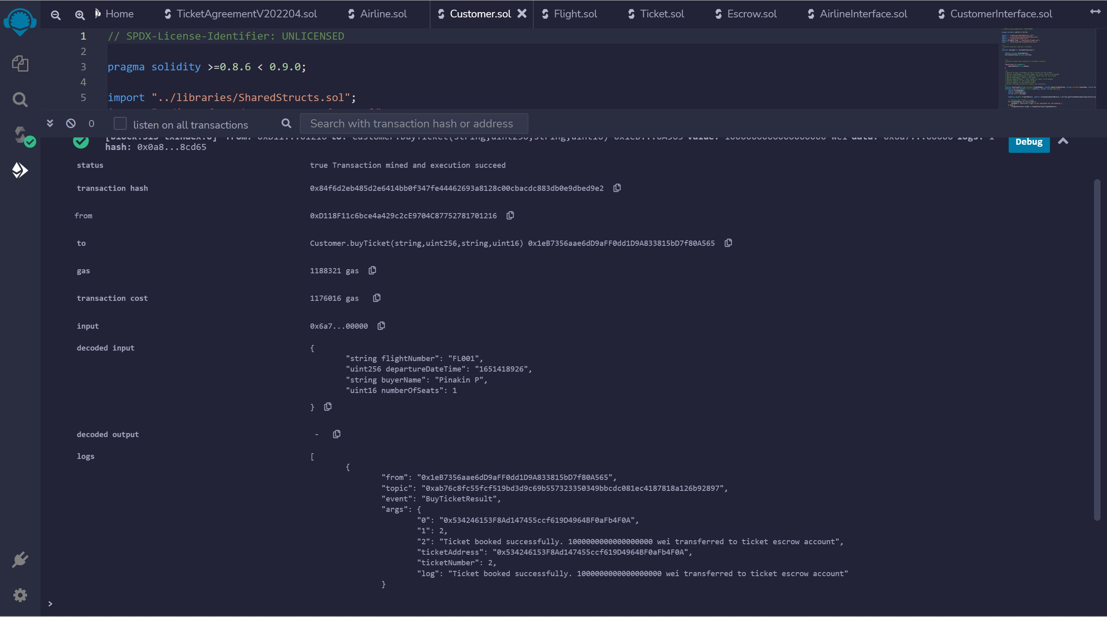
CUSTOMER BUY TICKET - TXN

Slide 35
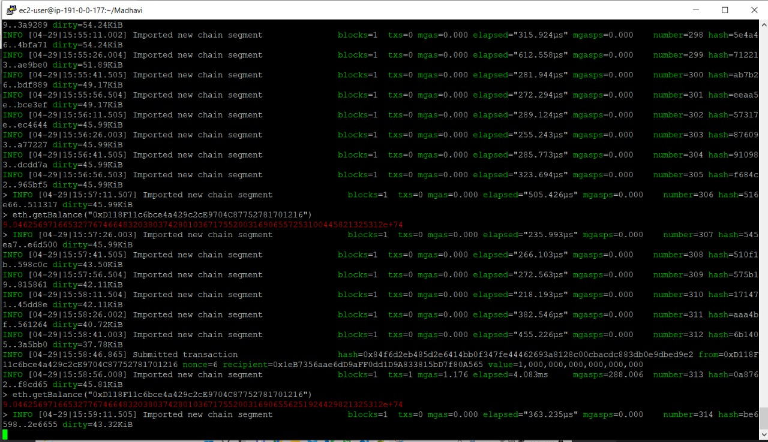
CUSTOMER BALANCE – AFTER TXN

Slide 36
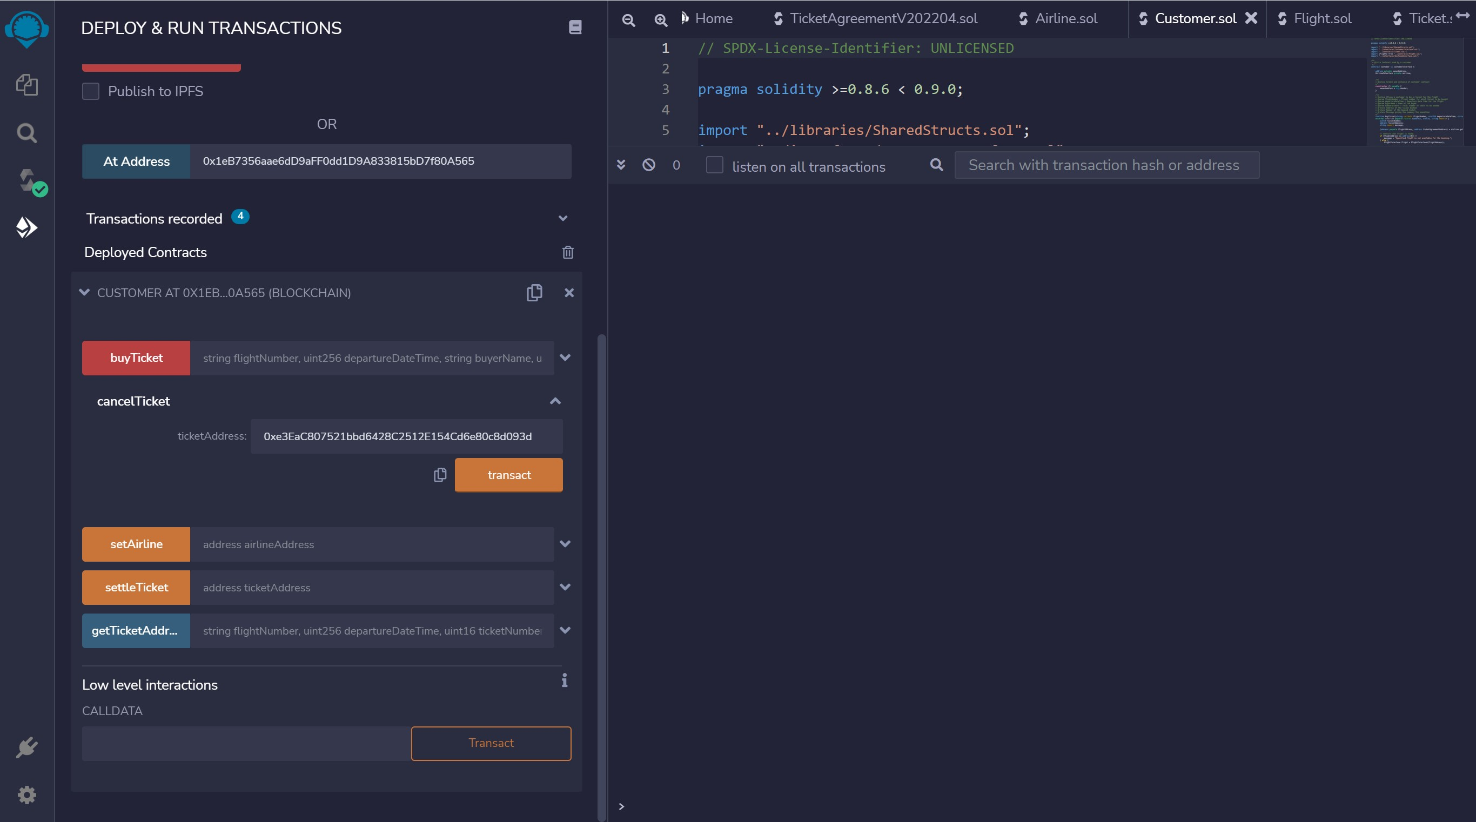
CUSTOMER CANCEL TICKET

Slide 37
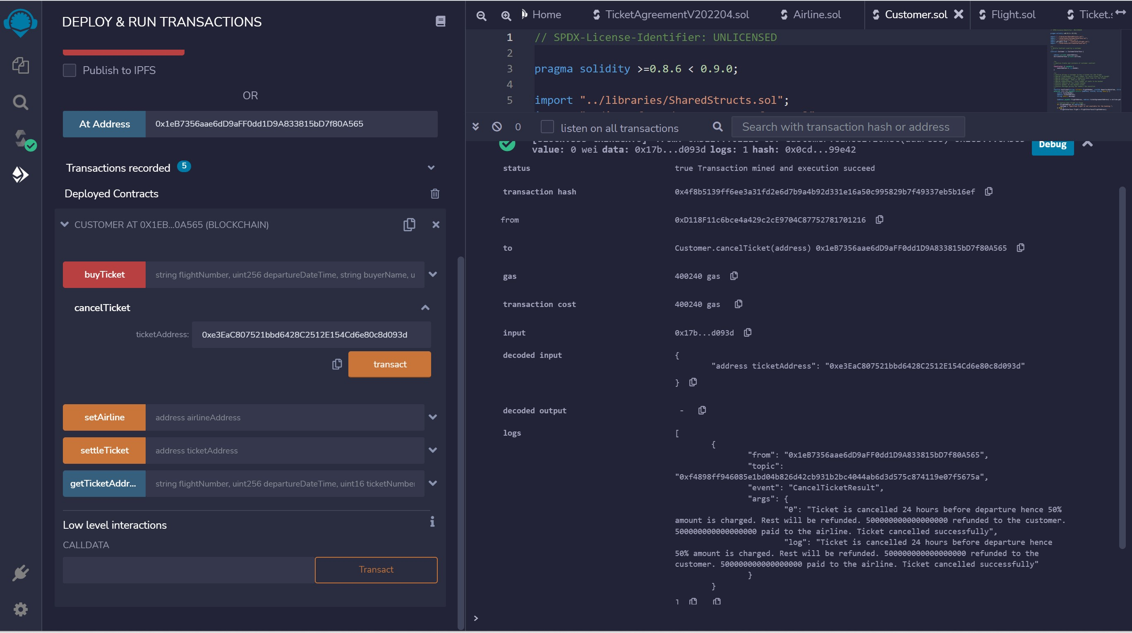
CUSTOMER CANCEL TICKET - TXN

Slide 38
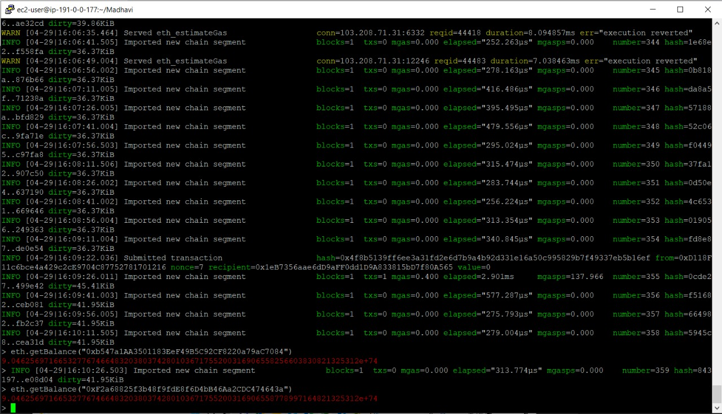
GET BALANCE AIRLINE ACCOUNT MINER 2

Slide 39
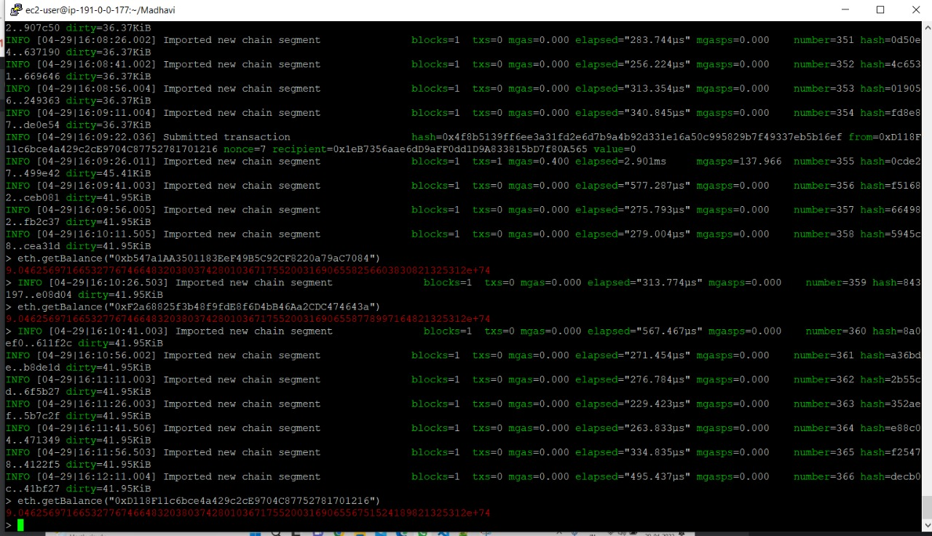
CUSTOMER GET BALANCE

Slide 40
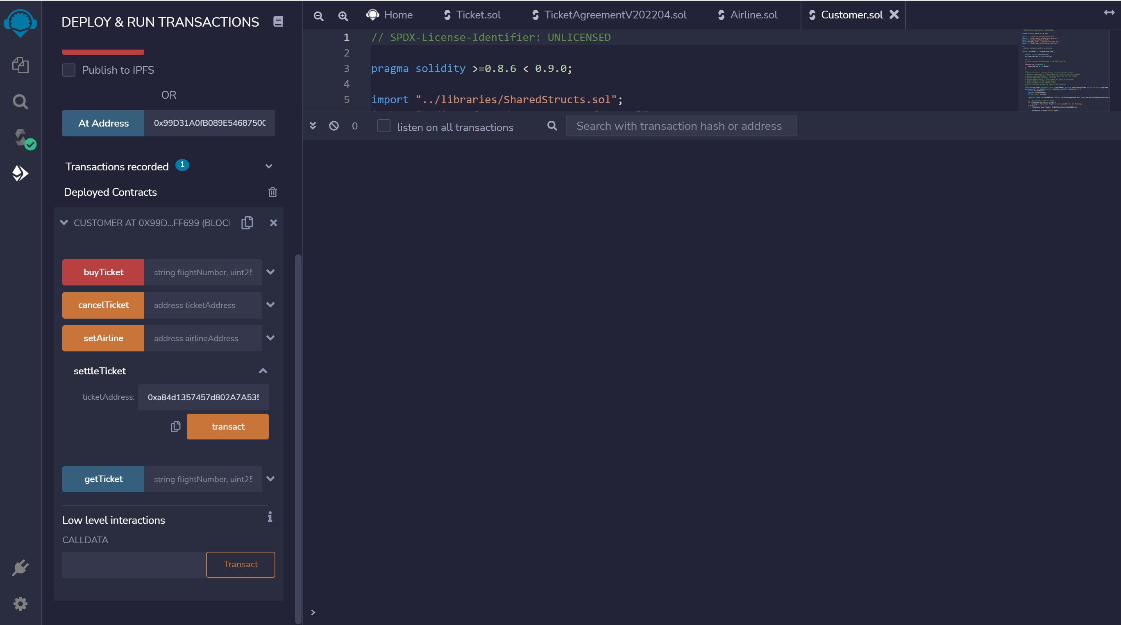
CUSTOMER SETTLE TICKET

Slide 41
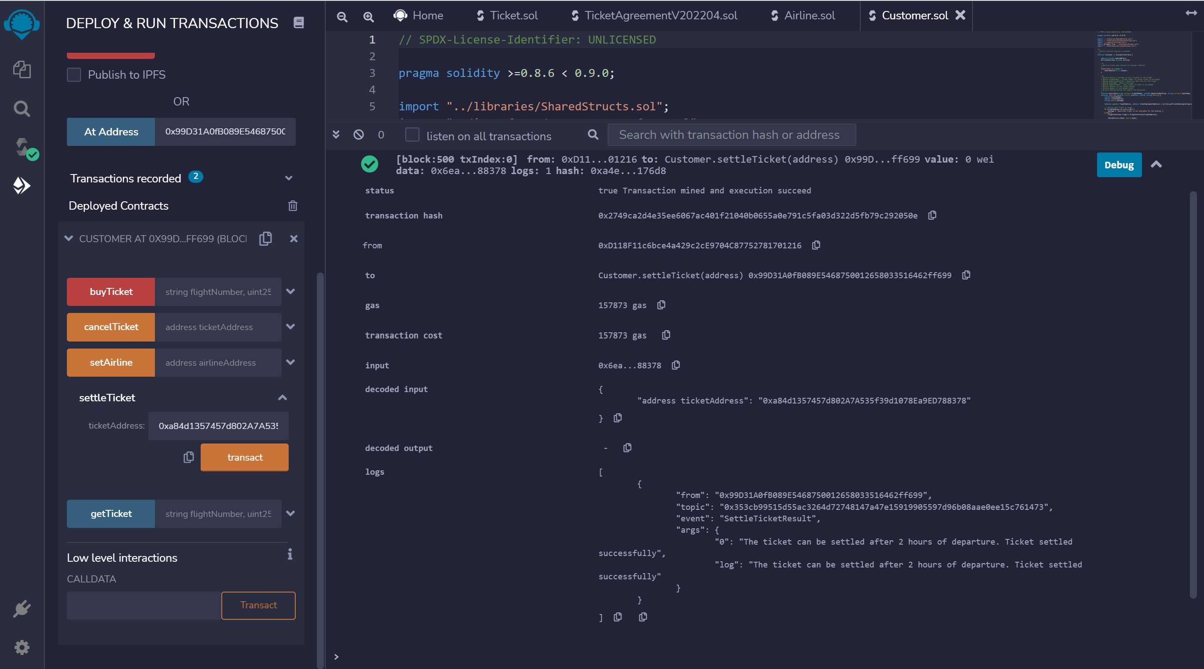
CUSTOMER SETTLE TICKET -TXN

Slide 42
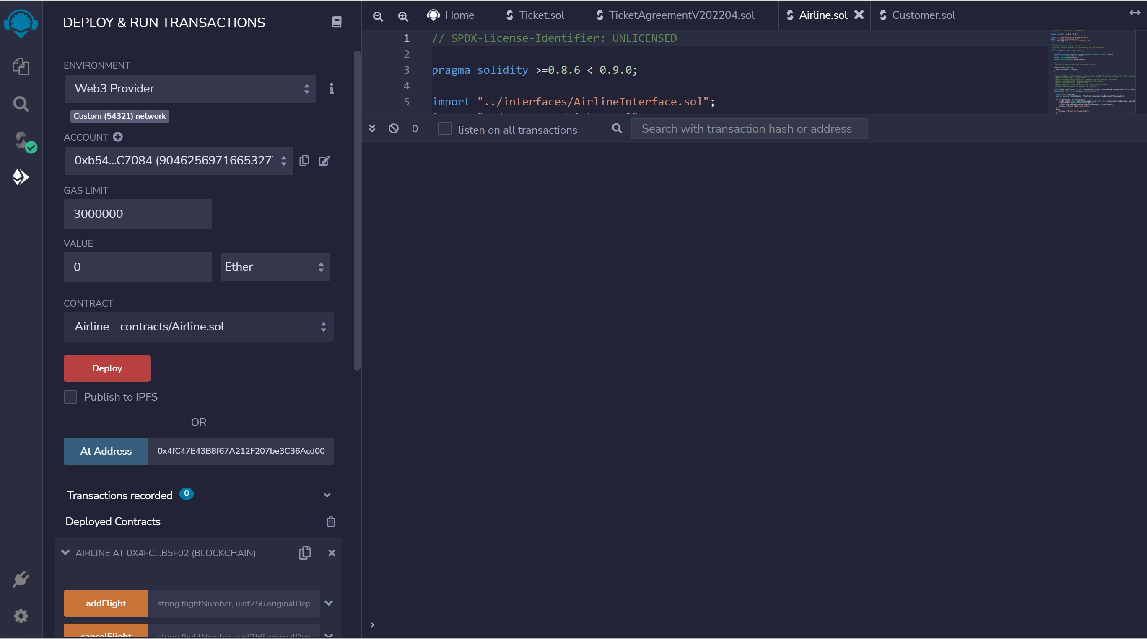
CONNECT TO AIRLINE MINER ACCOUNT 1

Slide 43
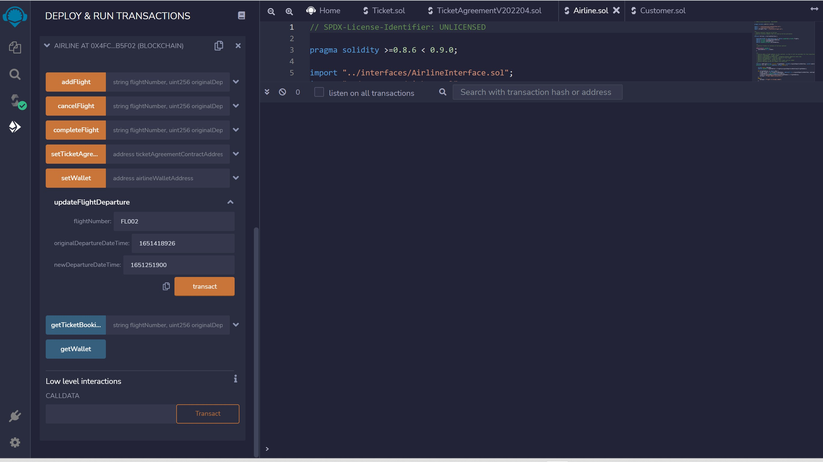
AIRLINE UPDATE DEPARTURE

Slide 44
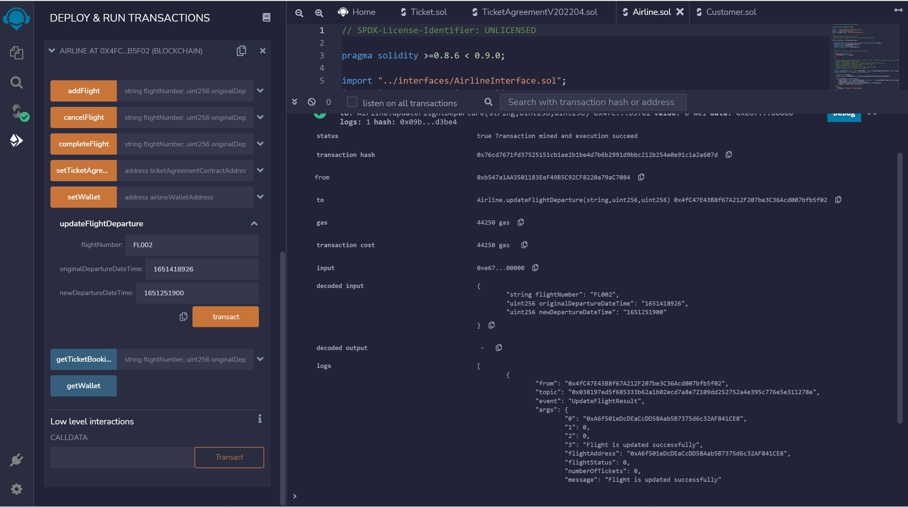
AIRLINE UPDATE DEPARTURE - TXN

Slide 45
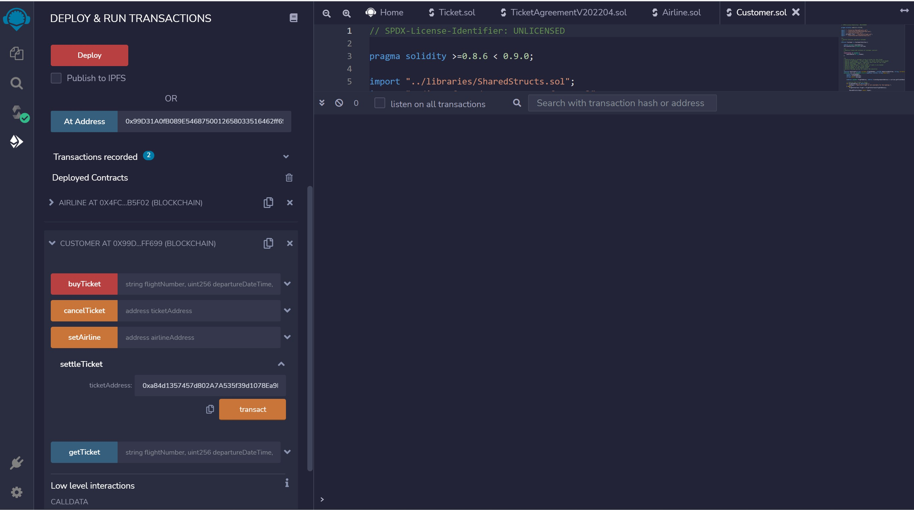
CUSTOMER SETTLE TICKET

Slide 46
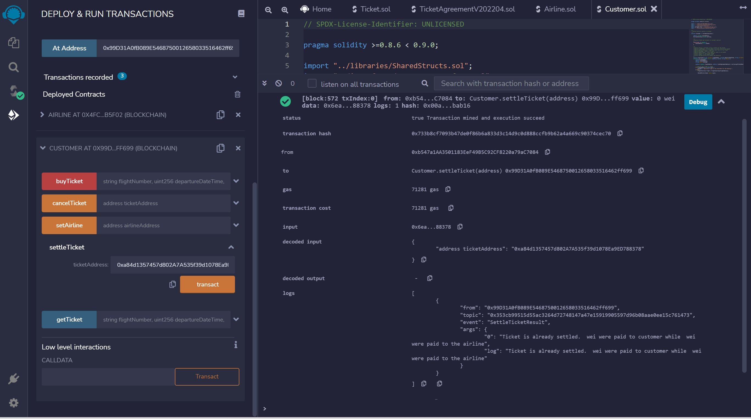
CUSTOMER SETTLE TICKET - TXN

Slide 47
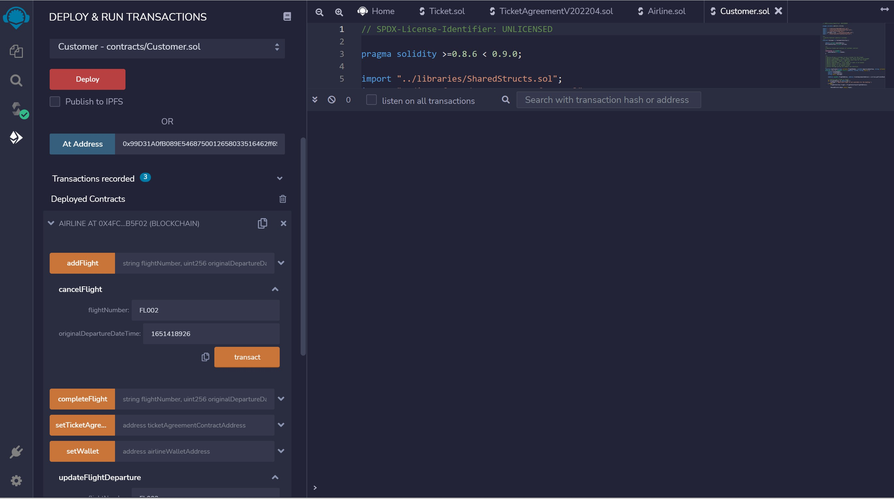
AIRLINE CANCEL FLIGHT

Slide 48
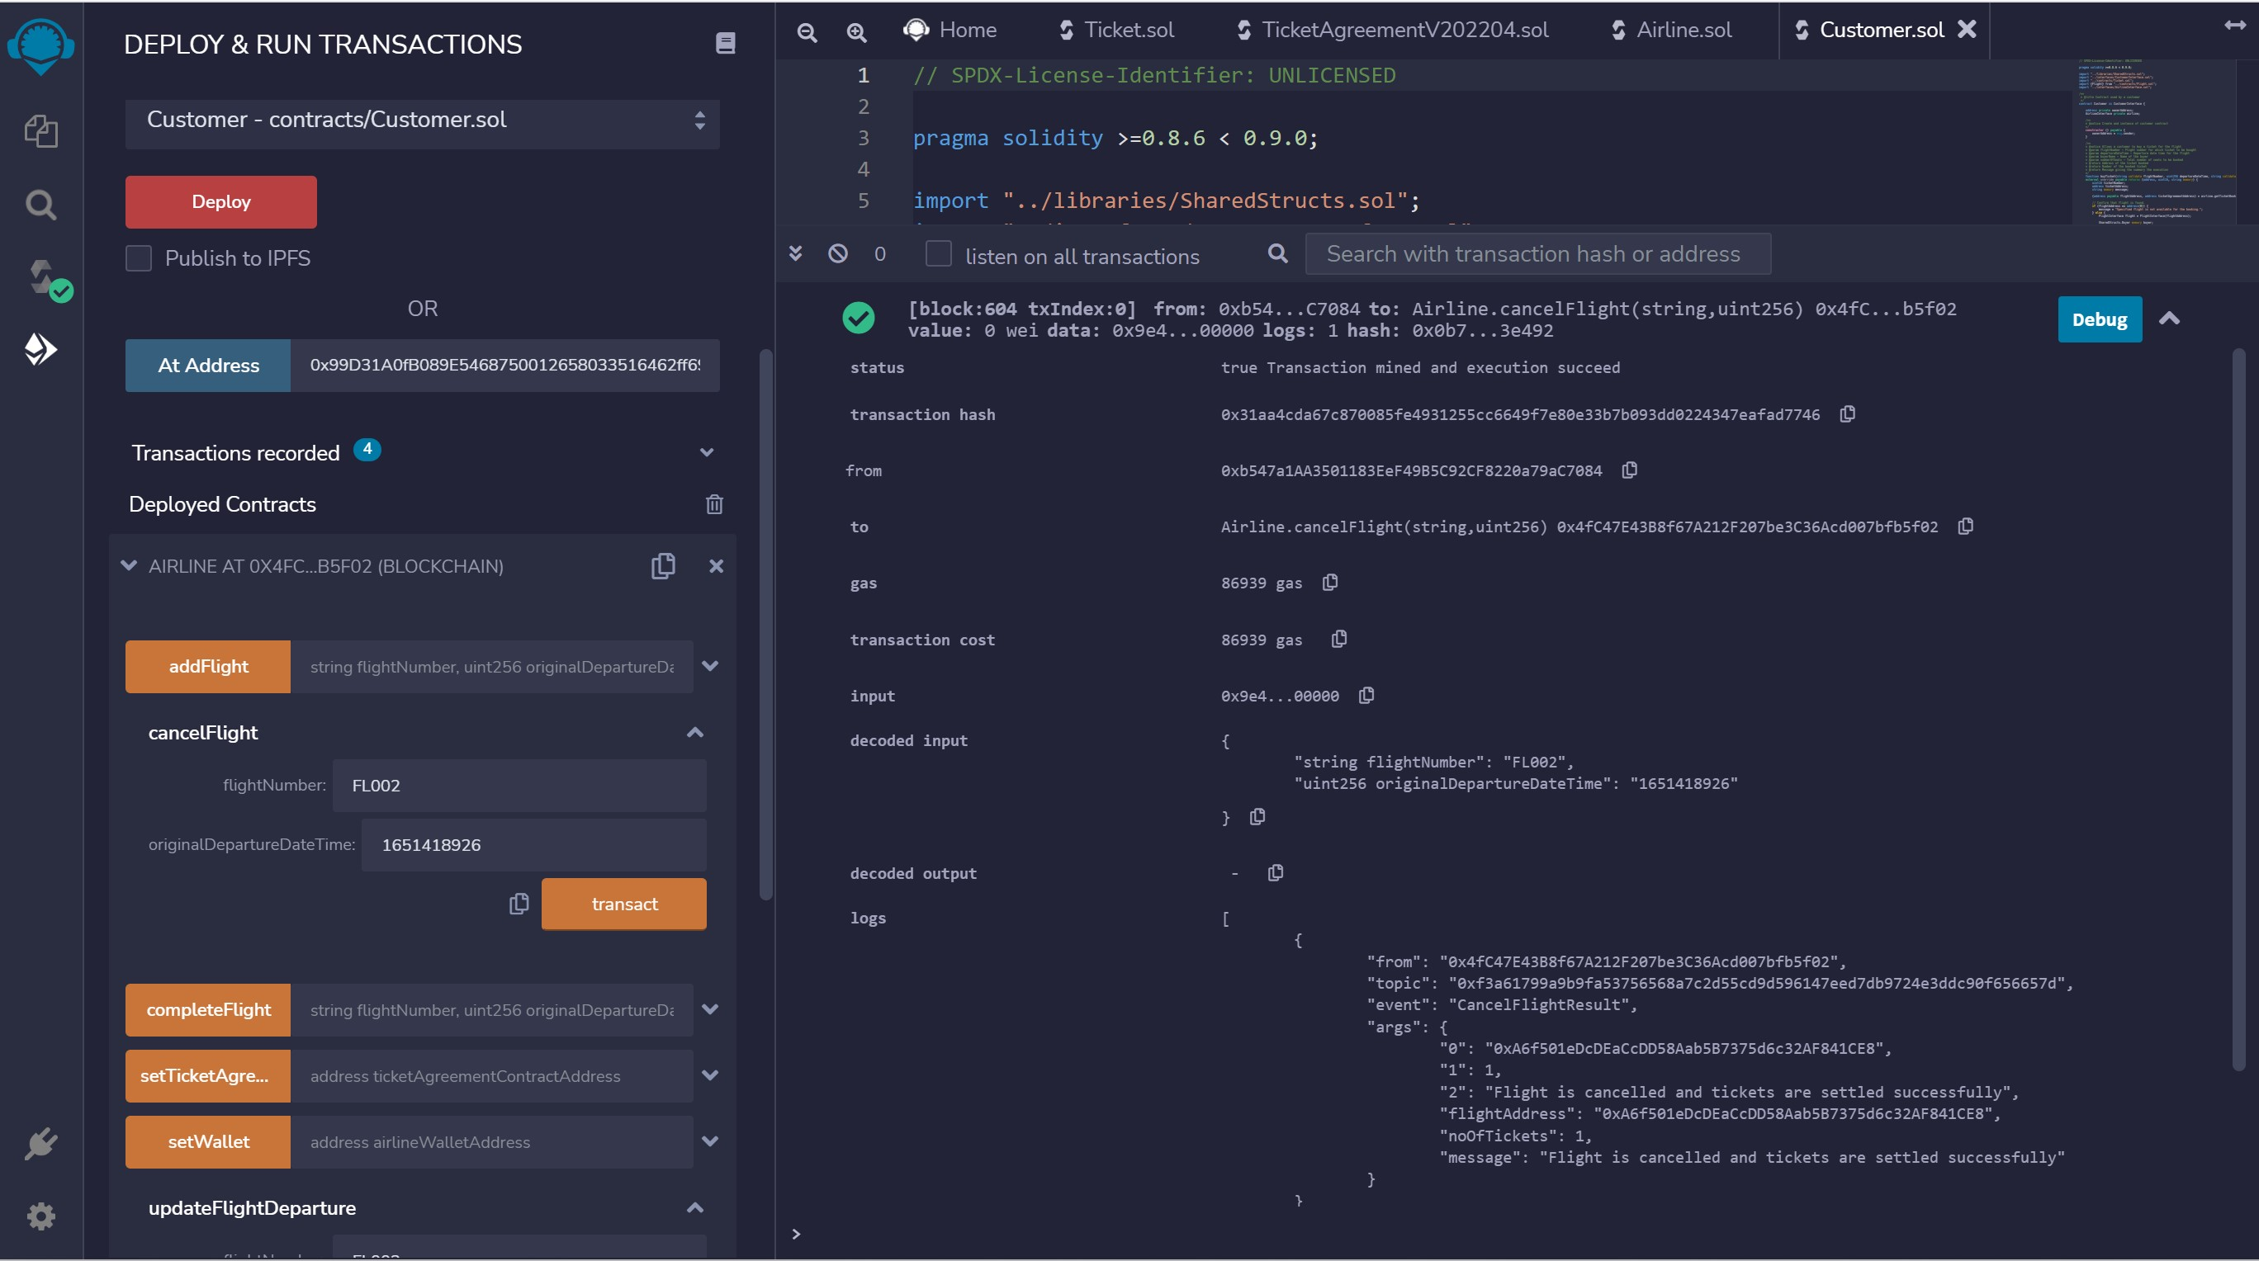
AIRLINE CANCEL FLIGHT - TXN

Slide 49
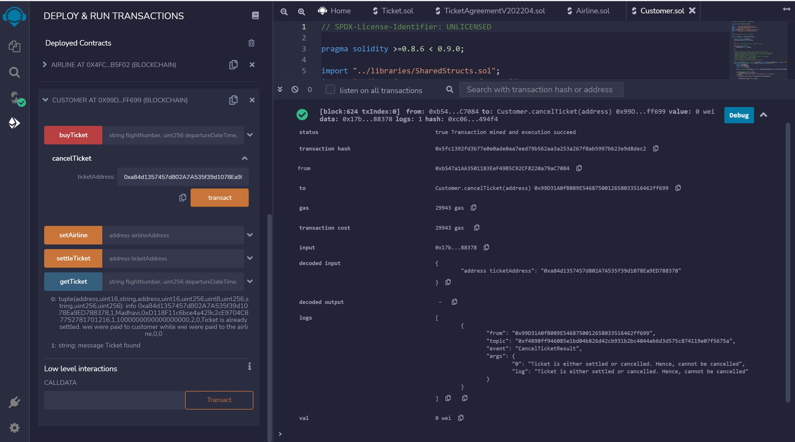
CUSTOMER CANCEL TICKET - TXN

Slide 50
PENDING
CHAINLINK INTEGRATION FOR FLIGHT INFORMATION

Slide 51
Thanks

